Slide 1
course 2024 arnaud.nauwynck@gmail.com @All Rights reserved
this document: http://github.com/arnaud-nauwynck/Presentations/big-data/ 4-hadoop-ecosystem
Hadoop Ecosystem
Main Components Explained
Hadoop is Dead - Long life Spark+ Kubernetes

Slide 2
Outline
ZooKeeper
Hdfs
Yarn
Oozie
Next part 5
HiveMetaStore, Parquet, Spark

Slide 3
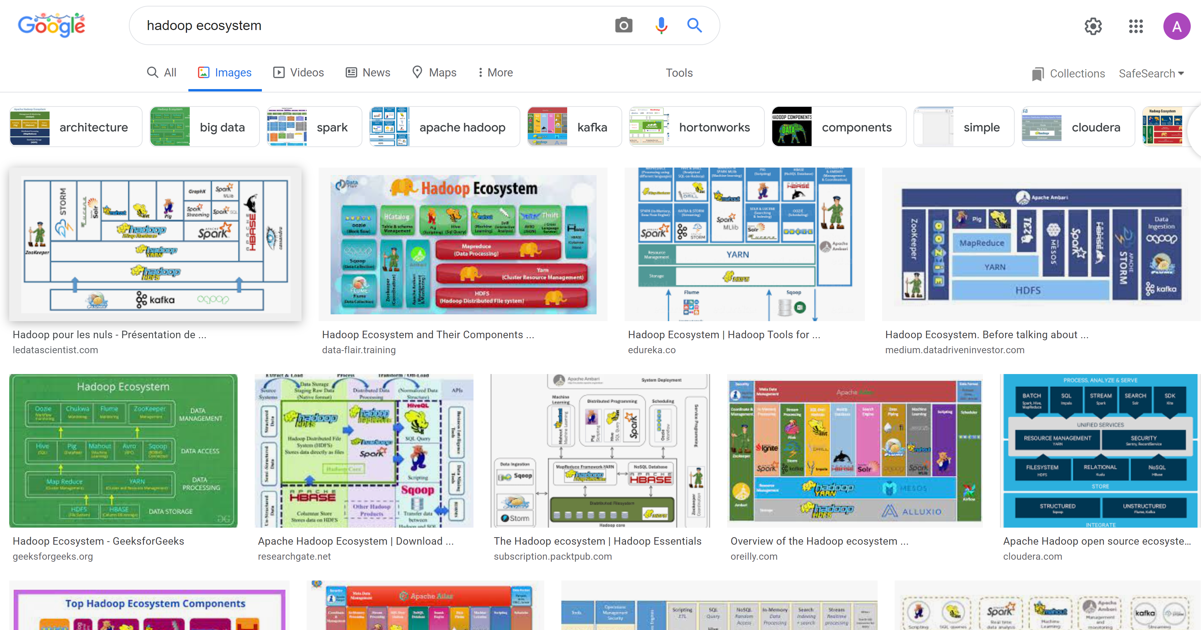
Google image ”Hadoop ecosystem”

Slide 4
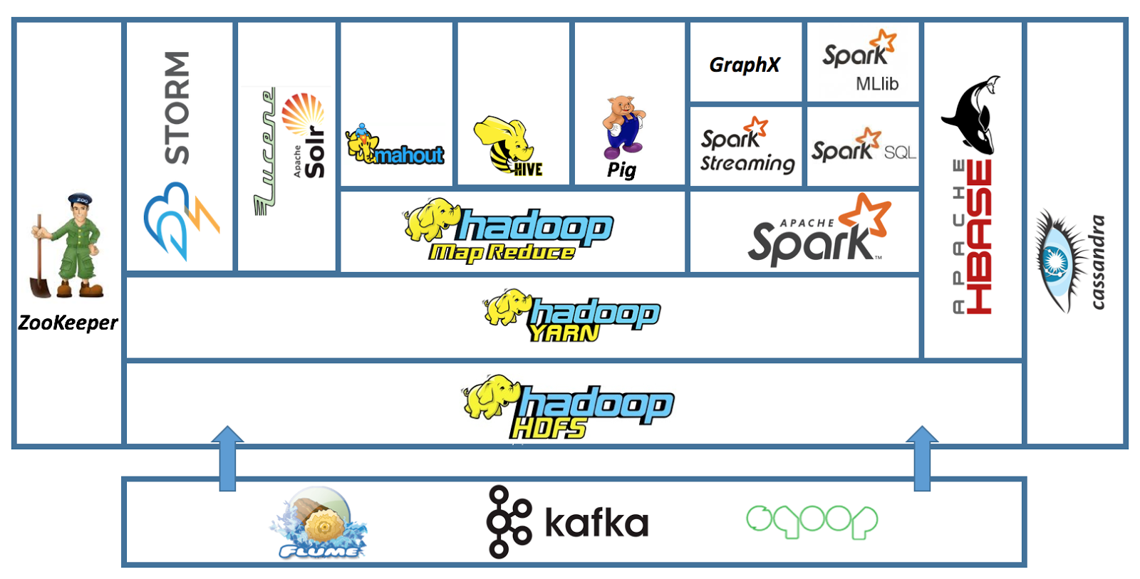
Hadoop Ecosystem..

Slide 5
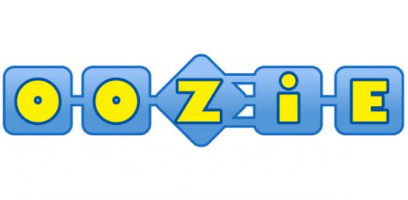



Low-Level Focus ZooKeeper, HDFS, Yarn, Oozie

Slide 6



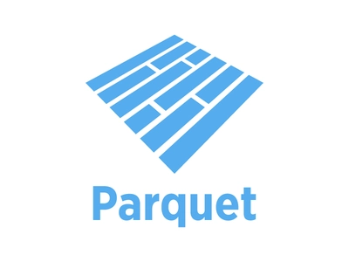
Next Part4,5 … High-Level Focus MetaStore, Parquet, Spark
metastore

Slide 7
ZooKeeper

Slide 8
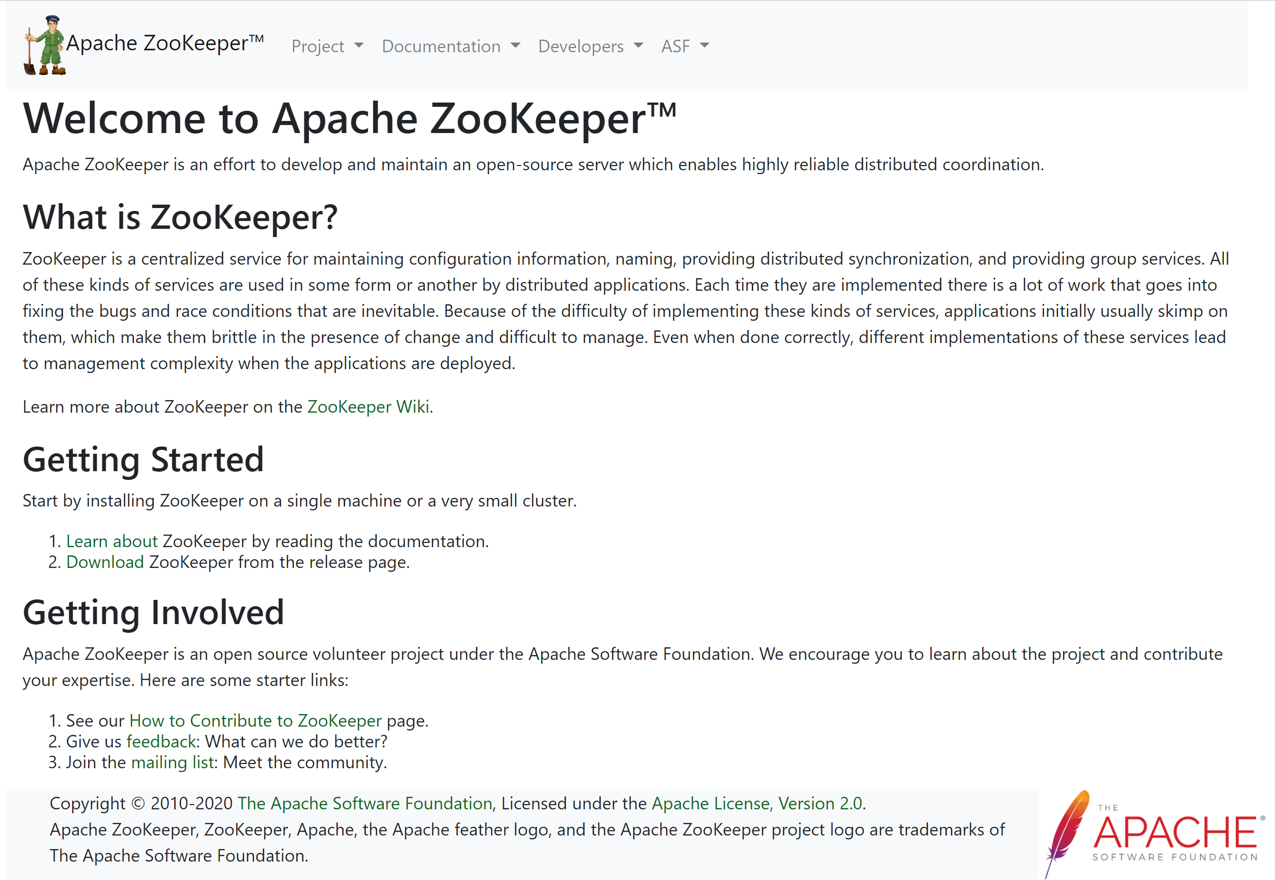
https://zookeeper.apache.org/

Slide 9
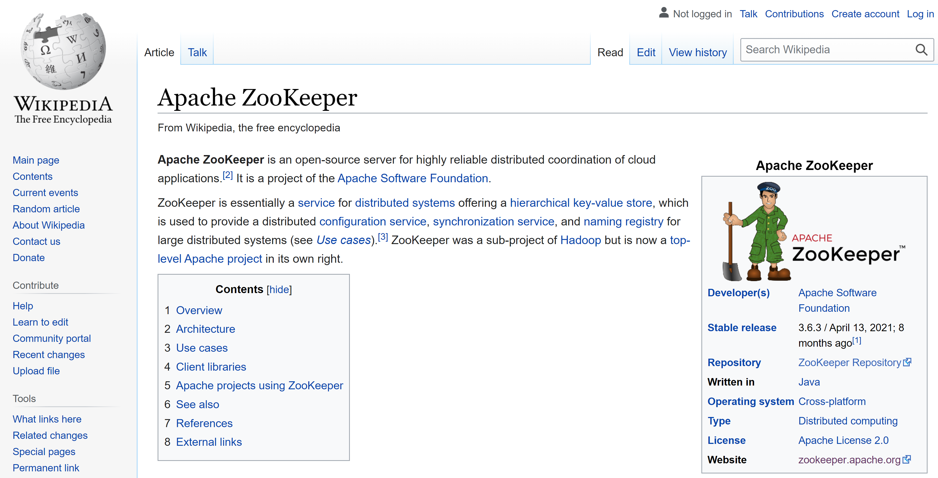
https://en.wikipedia.org/wiki/Apache_ZooKeeper

Slide 10
Hierarchical Key-Value Store
Zk Ensemble
Cluster
Get /path
Set /path value
Ls /path
Listen /path
Zk Client

Slide 11
Zk Shell
[zkshell: 0] help
ZooKeeper host:port cmd args
get path [watch]
ls path [watch]
set path data [version]
delquota [-n|-b] path
quit
printwatches on|off
createpath data acl
stat path [watch]
listquota path
history
setAcl path acl
getAcl path
sync path
redo cmdno
addauth scheme auth
delete path [version]
setquota -n|-b val path
[zkshell] create /zk_test my_data1
Created /zk_test
[zkshell] ls /
[zookeeper, zk_test]
[zkshell] set /zk_test my_data2
[zkshell] get /zk_test
my_data2
cZxid = 5
ctime = Fri Jun 05 13:57:06 PDT 2009
mZxid = 5
mtime = Fri Jun 05 13:57:06 PDT 2009
...

Slide 12
Zk Session, EphemeralNode, Watch
ZooKeeper focus:
Atomic updates / locks
Inherit ACL per node
Connection / Session (EphemeralNode for active session)
Realtime Watch

Slide 13
ZNode
Znode « / »
Znode « /data »
« /prop » = value
Get key..
Set key=value
List key/*
Listen Key
Znode « /servers »
EphemeralZNode « node1»
EphemeralZNode « node2»
Example for service discovery :
Listen « /servers/* »
EphemeralZNode « node3»

Slide 14
ZooKeeper Model
1
Watch
ZNode
child
ConnectionSession
*
1
0..1 parent
EphemeralZNode
(Persistent)ZNode

Slide 15
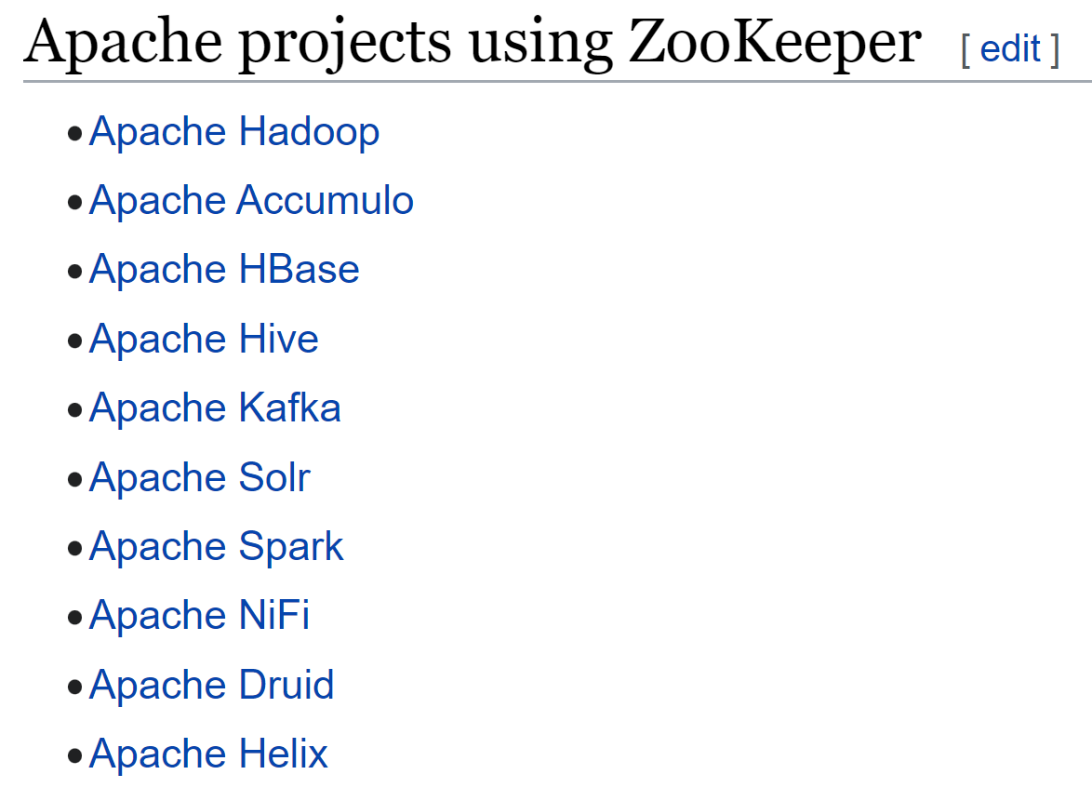
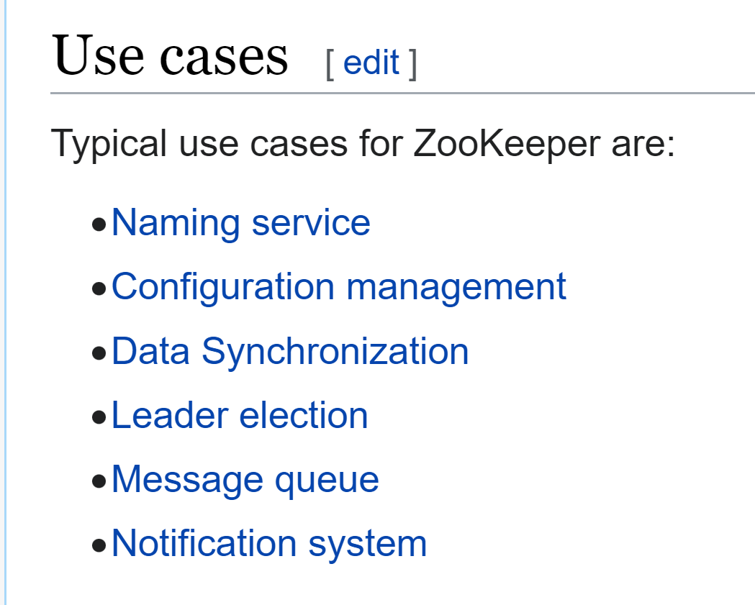
Usages within Hadoop
Kafka 3 … no more ZooKeeper
? support but no usage in Spark
? Wikipedia missing Apache BookKeeper
( and Apache Pulsar)

Slide 16
Zk Quorum Write
2/ atomic change
+ write to WAL
3/ broadcast change
+ quorum for commit
1/ Forward
write request
to current Leader
Read requests:
directly from nodes
Get key..
Set key=value
List key/*
Listen Key

Slide 17
ZooKeeper : CP … for small, mostly read data
Not a General Purpose Key-Value Database
All in memory ( + file + WAL ) !!
All operations are serialized, and wait Quorum
… Focus on consistency, Not “Available” in CAP

Slide 18
Zk Alternatives
Initially inspired by Google Chubby
Redis
https://etcd.io/
(“A distributed, reliable key-value store for the most critical data of a distributed system”) … kernel of Kubernetes !
Gossip, Raft Protocols
https://atomix.io/ (“java library for fault tolerant distributed system”)
Curator (library wrapper for low-level Zookeeper api)

Slide 19
Zk Summary
Extremely Robust & Mature
store only critical data (small, mostly read)
Low-level API, wrap in Curator
Etcd better (Kubernetes choice)
… often: no need to use directly

Slide 20
HDFS Hadoop Distributed File System

Slide 21

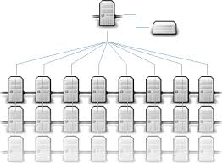
HDFS name explained
A FileSystem for directories and Files
Like NTFS(windows), Ext4(linux), Ceph(distributed) ...
Distributed
works on cluster of >=100 nodes >= 1000 disks
… to store Peta bytes
For/by Hadoop
API is also used by Spark or others..
implemented by AWS,Azure..
Abstract class FileSystem
class DistributedFileSystem

Slide 22
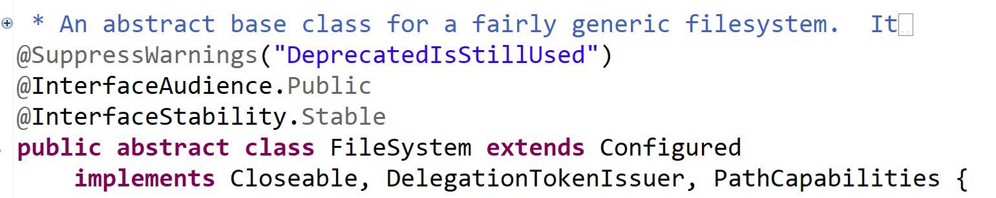
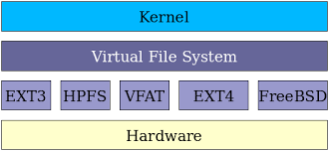
Abstract API / Concrete Implementation
Comparison with Linux
API
Implementations

Slide 23
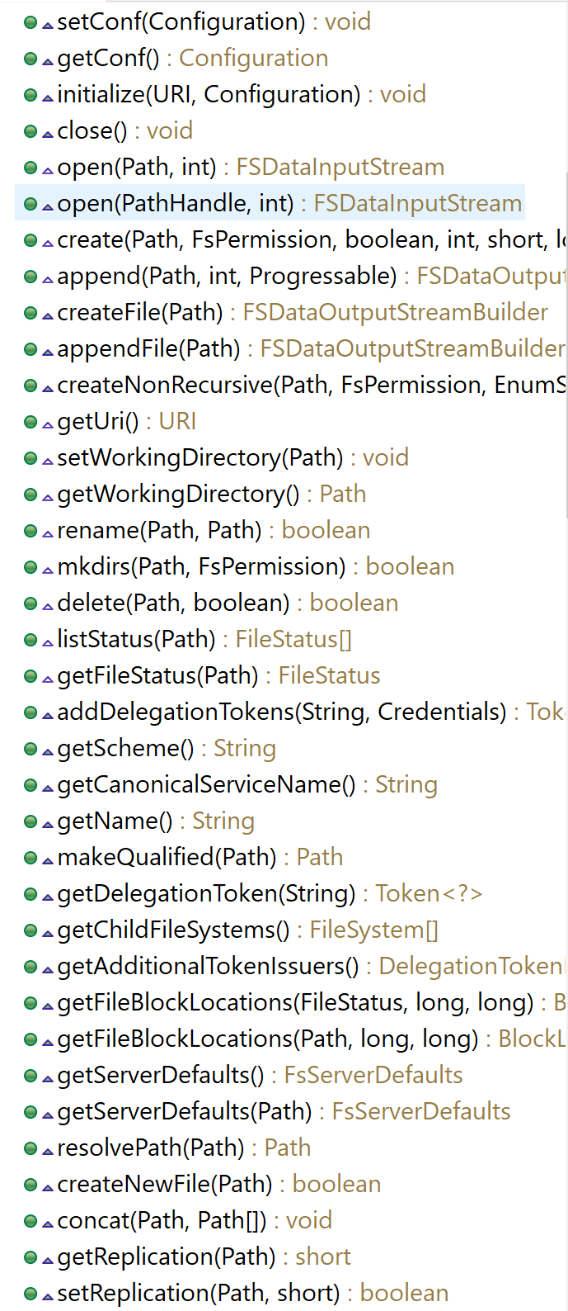
API
Standard operations
mkdir, list, rm, rename…
For file: Append ONLY FileSystem
To overwrite a single byte => overwrite all
Only 1 exclusive writer
Seek possible only in Read mode

Slide 24
Api UML Classes
Path
FSDataOutputStream
(Append only)
FSDataInputStream
Abstract class FileSystem
(can seek)
FileStatus
class DistributedFileSystem
*
INode
1
Dir
File
SymLink
Checkpoint
*
(server-side only)
Block

Slide 25
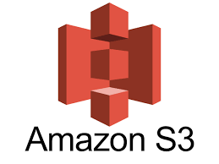
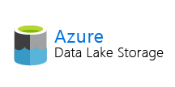
Not only HDFS ...
InstrumentedFileSystem
Abstract class FileSystem
YourCustomFileSystem
DistributedFileSystem
LocalFileSystem
S3FileSystem
Legacy HDFS
With weakness
NameNode
+ DataNode
+ DelegationToken
+ ...
AbfssFileSystem
ViewDistributedFileSystem
Federating cluster, with “mount” point

Slide 26
$ hdfs dfs <cmd> <args..>
$ hdfs dfs -ls “/a/b”
$ hdfs dfs -mkdir “/a/b/c”
$ hdfs dfs -put localFile “/a/b/c/remoteFile”
$ hdfs dfs -get “/a/b/c/remoteFile” localFile
$ hdfs dfs -cp -r “/a/b” “/a/bCopy”
$ hdfs dfs -rm -r “/a/b” “/a/bCopy”

Slide 27
Hadoop Implementation Limits
OK to store Peta bytes, with files > Giga octets
BUT HDFS does not like “Small” Files ( “Too many” Files ) !!
i.e. > 200 Millions… with NameNode jvm > -Xmx200G …
NameNode is THE bottleneck of HDFS

Slide 28
NameNode ...
All metadata (“name”) operations starts with the NameNode
NameNode maintains all metadata files in jvm memory !! 1 File ~ 4ko
Huge RAM + Disk needed
JVM needs GC Tuning
The NameNode is critical (gc / corrupted file / crashing => system OFF )
NameNode manages kerberos delegation token

Slide 29
HDFS = 2 NameNodes + N x DataNodes
DataNode
DataNode
NameNode (active)
FsImage
FsEdit
DataNode
FsEdit
Replicate
fsedit
DataNode
DataNode
NameNode (standby)
FsImage
DataNode
FsEdit
1/ Metadata operation
1/ Metadata operation
1/ Metadata operation
2,3..N/ read/write blocks
HdfsClient

Slide 30
DataNode … store blocks 1 File = N x Blocks (default: 128M)
Logical File metadata
“F1” = 3 blocks
DataNode
F1-block3
F1-block2
DataNode
F1-block2
F1-block1
DataNode
F1-block1
F1-block1
F1-block2
F1-block3
DataNode
F1-block3
DataNode
3 Replicates
of each block
F1-block3
F1-block1
DataNode
F1-block2
Physical Block repartition on DataNodes

Slide 31
RF (Replication Factor) = 3
active NameNode manage replications:
When a DataNode “disapears” => all its blocks are lost (blocks are under replicated)
=> need re-replicate corresponding blocks
When a DataNode “joins” cluster => it sends its “block-report”
=> blocks might be over-replicated => can be deleted
( at startup, NameNode is in “safe mode”… it waits enough block-reports to start useless replicating ! )

Slide 32
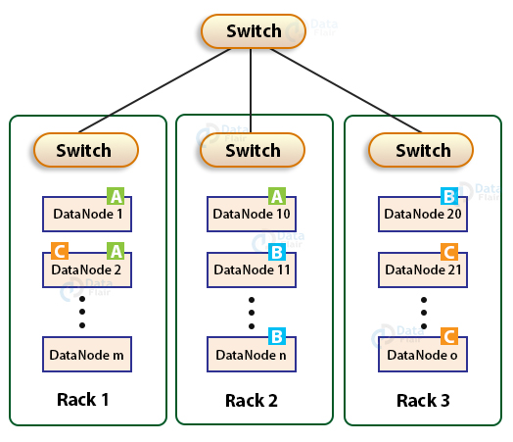
RF … Rack Aware
East-West traffic
Top-Rack switch
For North-South traffic
Can replicate 1
in same Rack
(fast)
Must replicate >=1
in another Rack

Slide 33
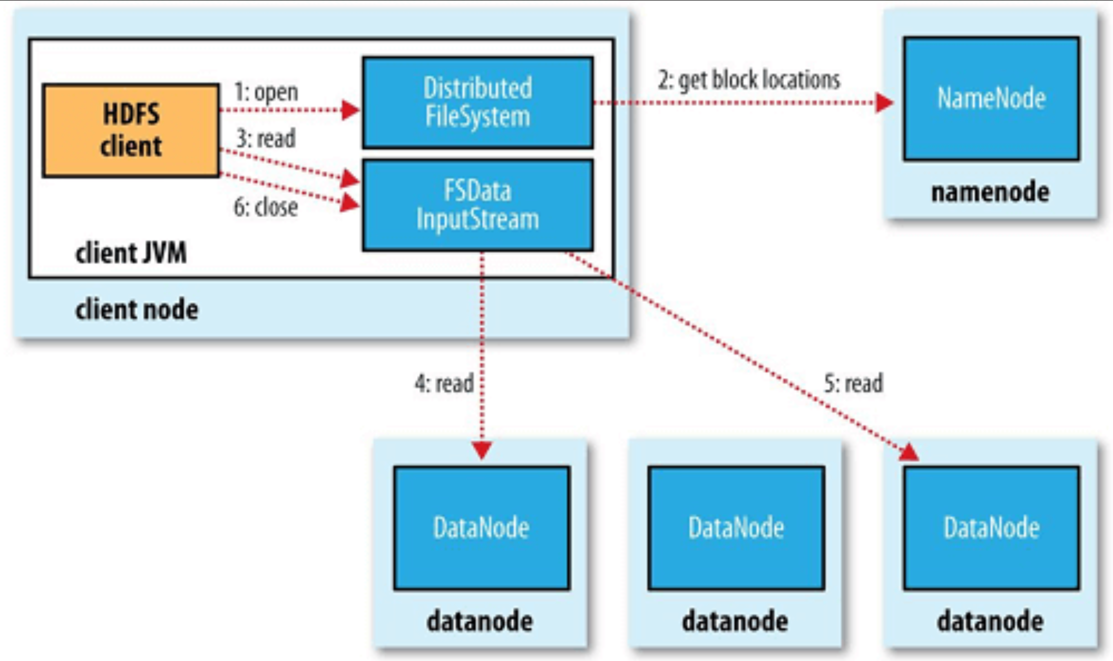
Reading a HDFS File

Slide 34
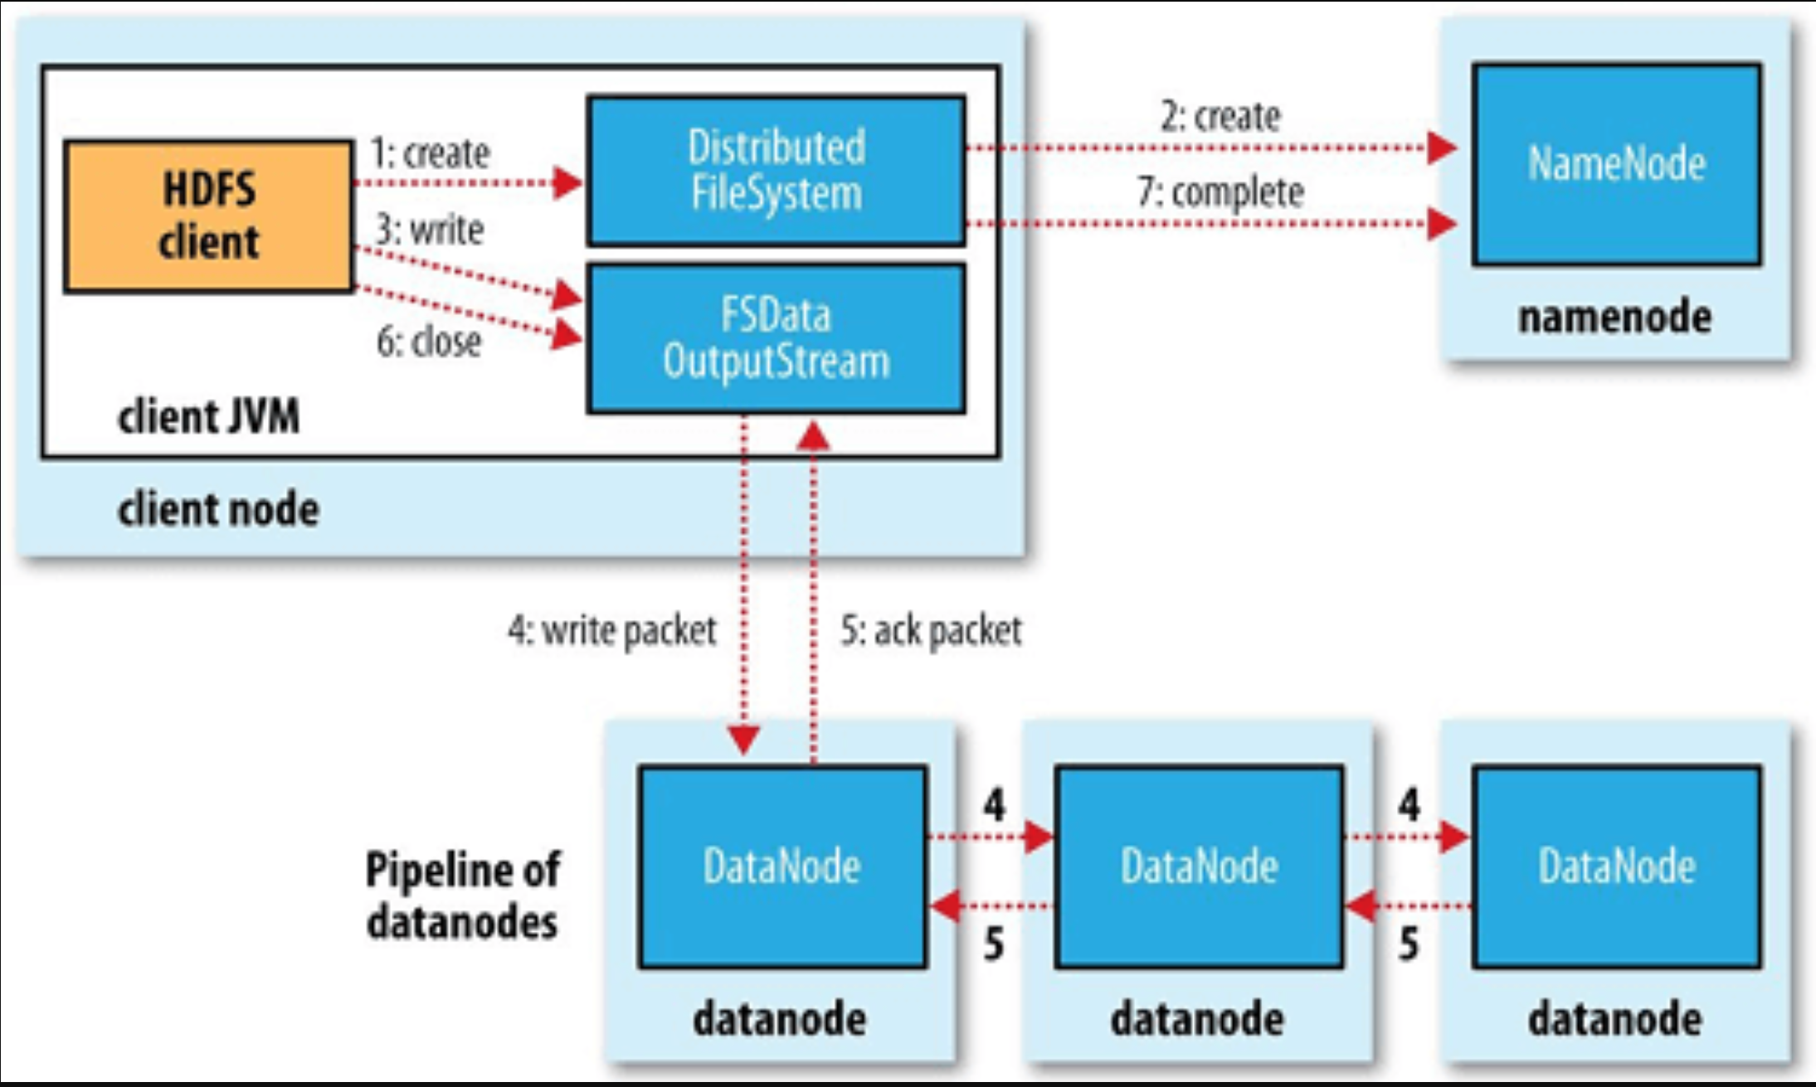
Writing a HDFS File
Default size … Block(128M) => packet(64K) => 126 * chunk（512b + checksum 4b）

Slide 35

MapReduce

Slide 36
MapReduce Principle
DataNode
DataNode
MapperTask
DataNode
ReduceTask
MapperTask
DataNode
OutputFile
InputFile
Job Conf
Job
1
*
Task
Mapper
Reducer

Slide 37
MapReduce .. replaced by Yarn (then Kubernetes) + Spark
Origin = Google paper
Job resources launcher refactored in “Yarn”
MapReduce 100x slower than Spark (inneficient saving to Hdfs)
=> Nobody use MapReduce anymore (except oozie, to launch shell commands)

Slide 38
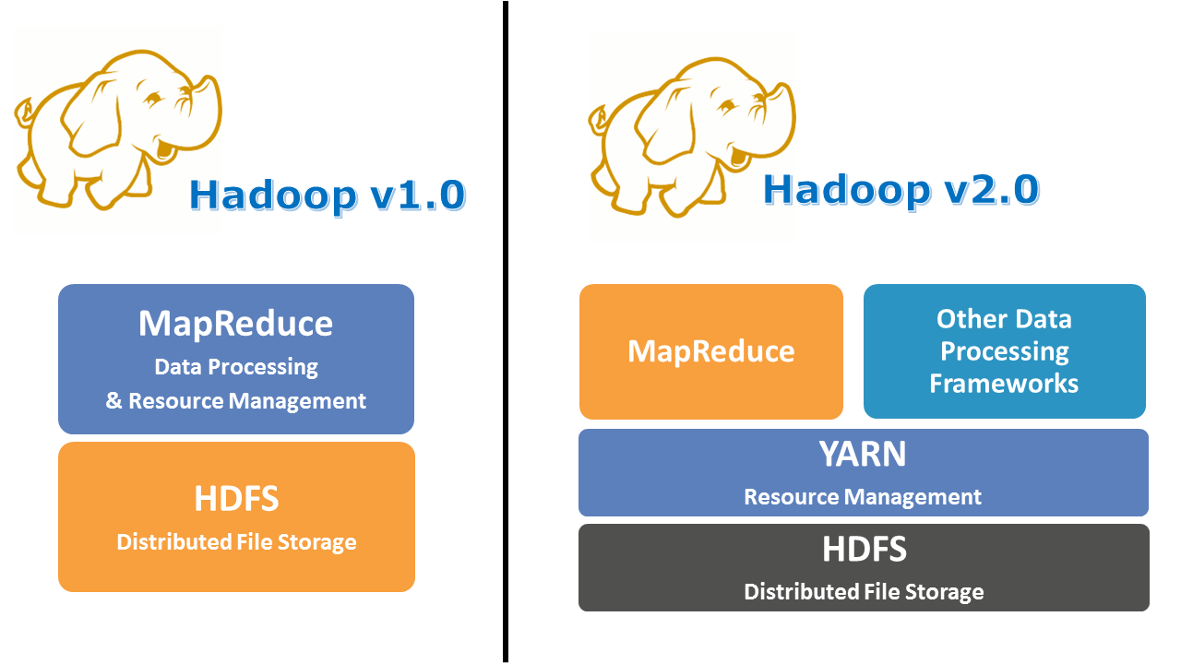
(legacy) Map Reduce … Yarn

Slide 39

Yarn

Slide 40
Yarn: Yet Another Resource Negotiation
SSH
< MapReduce1 (no more used)
< Mesos (~ nobody uses)
< Yarn v2 (stuck to Hadoop)
< Kubernetes ( … very Fashion since 2014 )
Google Borg / Omega (internal, inspiring Kubernetes)

Slide 41

Spark clustering supports
None --master local[*]
SSH (mode “standalone”) --master spark://IP:PORT
< Mesos (since 1.0 … deprecated in 3.2.0) --master mesos://host:5050
< Yarn v2
--master yarn
< Kubernetes (since 3.0)
--master k8s://https://<k8s-apiserver>
Past
Present
Future

Slide 42
Yarn Architecture
Yarn “RM”
Node
Node
… Node
1
Protobuf API
Http Rest
Web Yarnui
ResourceManager
NodeManager
NodeManager
(2) launch
(4,5..)
launch
AppMaster
ResourceManager
(3) request
resources
Container1
Container2
Cont 3..
(1) Submit app
Relational DB
eg. postgresql
Submit Client App

Slide 43
Comparison … Kubernetes
Etcd
Node
Node
… Node
1
kubelet
kubelet
(3,4..)
launch
Http Rest
Api Server
Operator
(2) request
resources
Container1
Container2
Cont 3..
(1) kubectl apply
kube Client

Slide 44
Yarn app: 3..N Java process Client+Master+N Containers
Prev Master Attempt
Master attempt 1
(maybe retry)
AppMaster
Container1
Container2
Submit Client App
...
ContainerN
Unmanaged
(maybe not in cluster)
Scheduled somewhere in cluster

Slide 45

Comparison with Kubernetes
ResourceManager
API Server
Relational DB
eg. postgresql
Etcd
NodeManager
Kubelet
Container
(Jvm, Docker)
Container (Docker,..)
App Master
( 1 per App)
K8s Operator (1 per Type)
Yarn Quota
K8s Quota
Yarn Fifo Queue
K8s extensions
(Volcano, UniKorn)

Slide 46
Main Difference with Kubernetes
Specific
Imperative system
Generic
Declarative system
you call the system
to (delegate) launch a java app
You save in the database "target state"
that a "Resource" should be managed
(example: a pod) by an operator.
$ kubectl apply -f spec.yaml

Slide 47
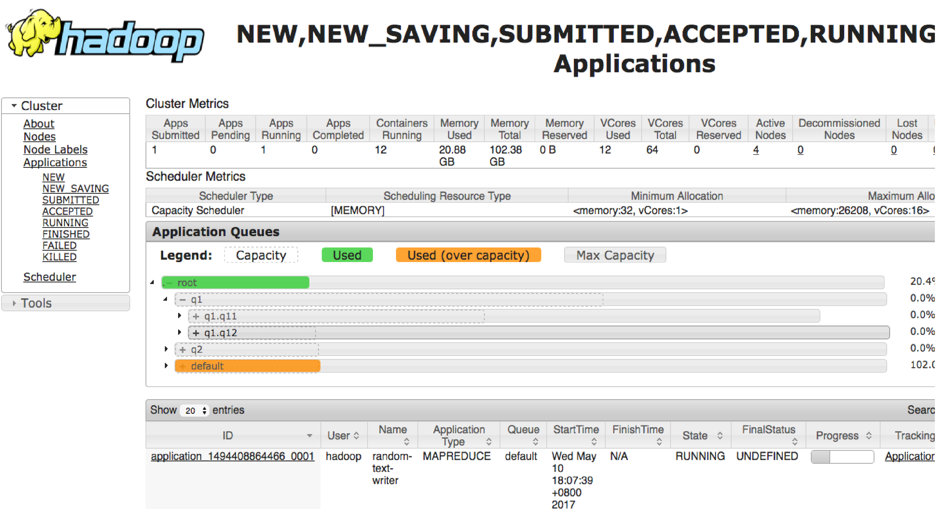
Yarn Queue
Queue Hierarchy :
Child queues => sum to 100%
Capacity / Max Capacity
… over-quota allowed
If Preemption enabled => may kill app in over-quota

Slide 48
Yarn Capacity Scheduler config
file: scheduler-conf.xml
<property>
<name>yarn.scheduler.capacity.root.queues</name>
<value>a,b,c</value>
</property>
<property>
<name>yarn.scheduler.capacity.{QueueXX}.{propertyYY}</name>
<value>..</value>
</property>
property:
.queues .. child queue names
.capacity 12.5 Queue capacity in %
.maximum-capacity 15.0 Maximum queue capacity in %
.minimum-user-limit-percent 100
.user-limit-factor 1
.maximum-allocation-mb 80G max memory for each container
.maximum-allocation-vcores 32 max vcores for each container
.weight 1.5

Slide 49


Kubernetes Queue … Volcano, UniKorn
# kubectl create -f job.yaml
apiVersion: batch.volcano.sh/v1alpha1
kind: Job
metadata:
name: job-1
spec:
minAvailable: 1
schedulerName: volcano
queue: test
policies:
- event: PodEvicted
action: RestartJob
tasks:
- replicas: 1
name: ..
policies:
- event: TaskCompleted
action: CompleteJob
template:
spec:
containers:
- ...
resources:
requests:
cpu: 1
limits:
cpu: 1
restartPolicy: Never
Not built-in in Kubernetes !
Allocation spark-driver => will allocate N x spark-executers
K8s built-in “pod scheduler” not adapted for BigData
https://volcano.sh
https://yunikorn.apache.org

Slide 50
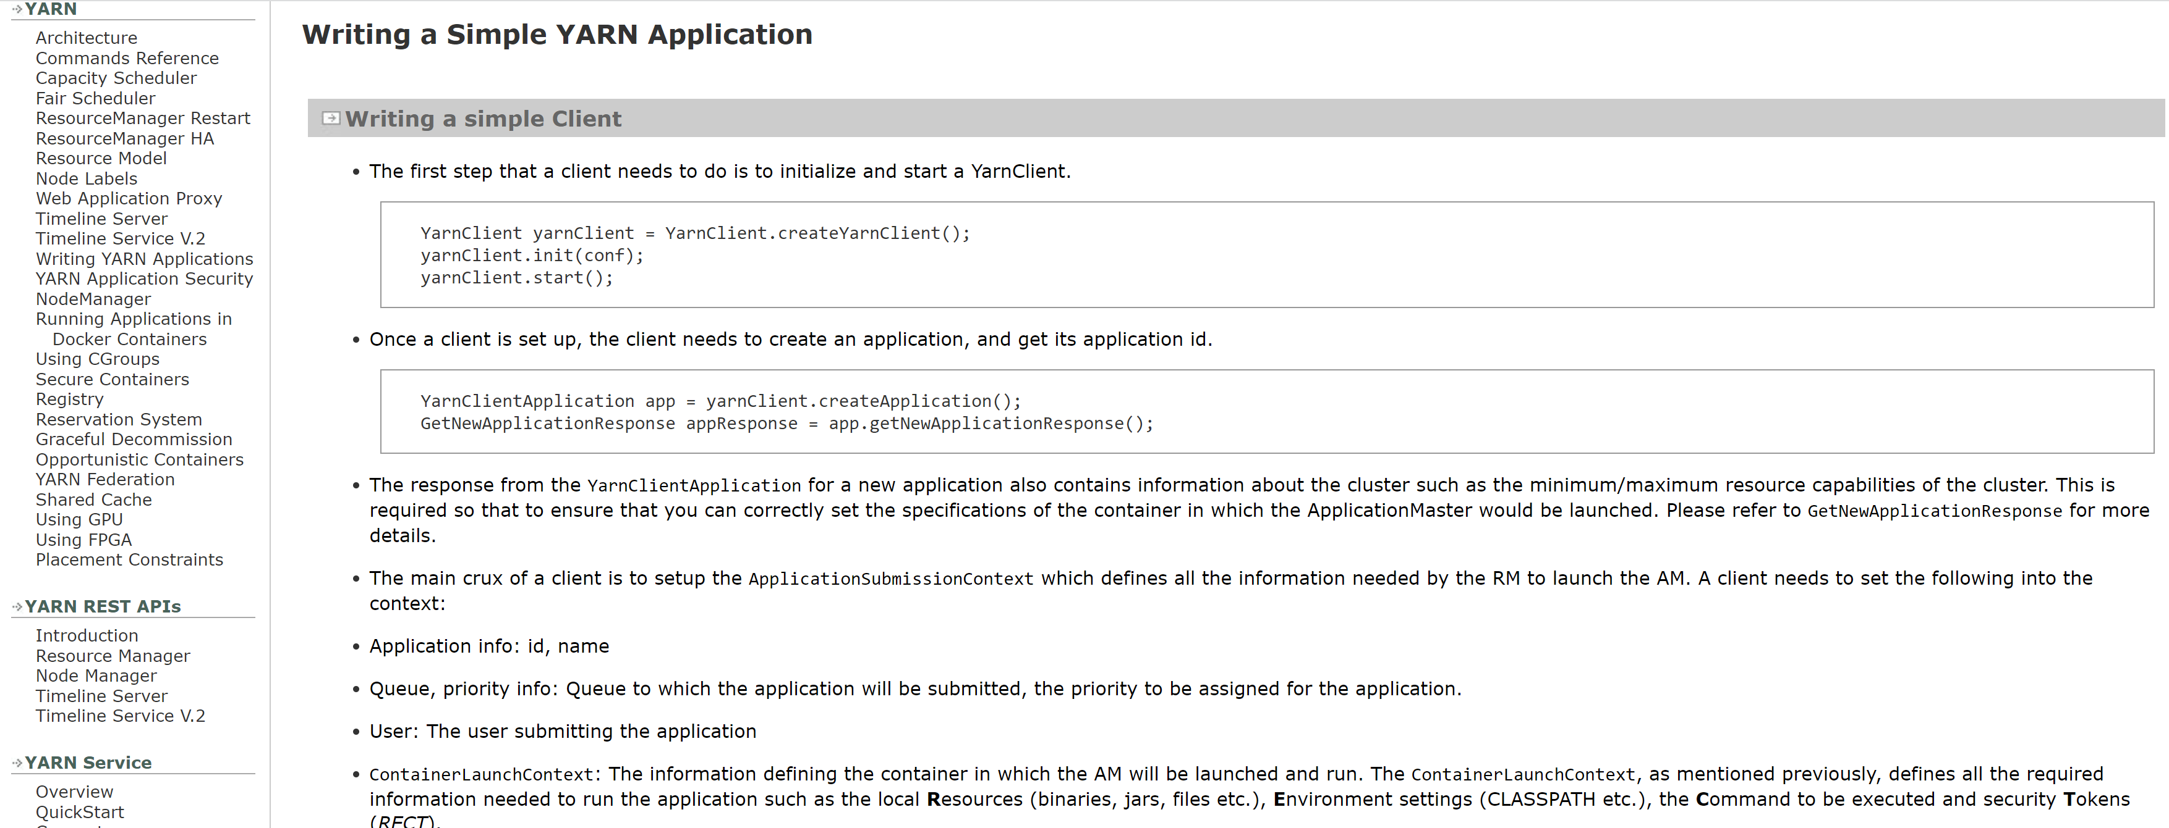
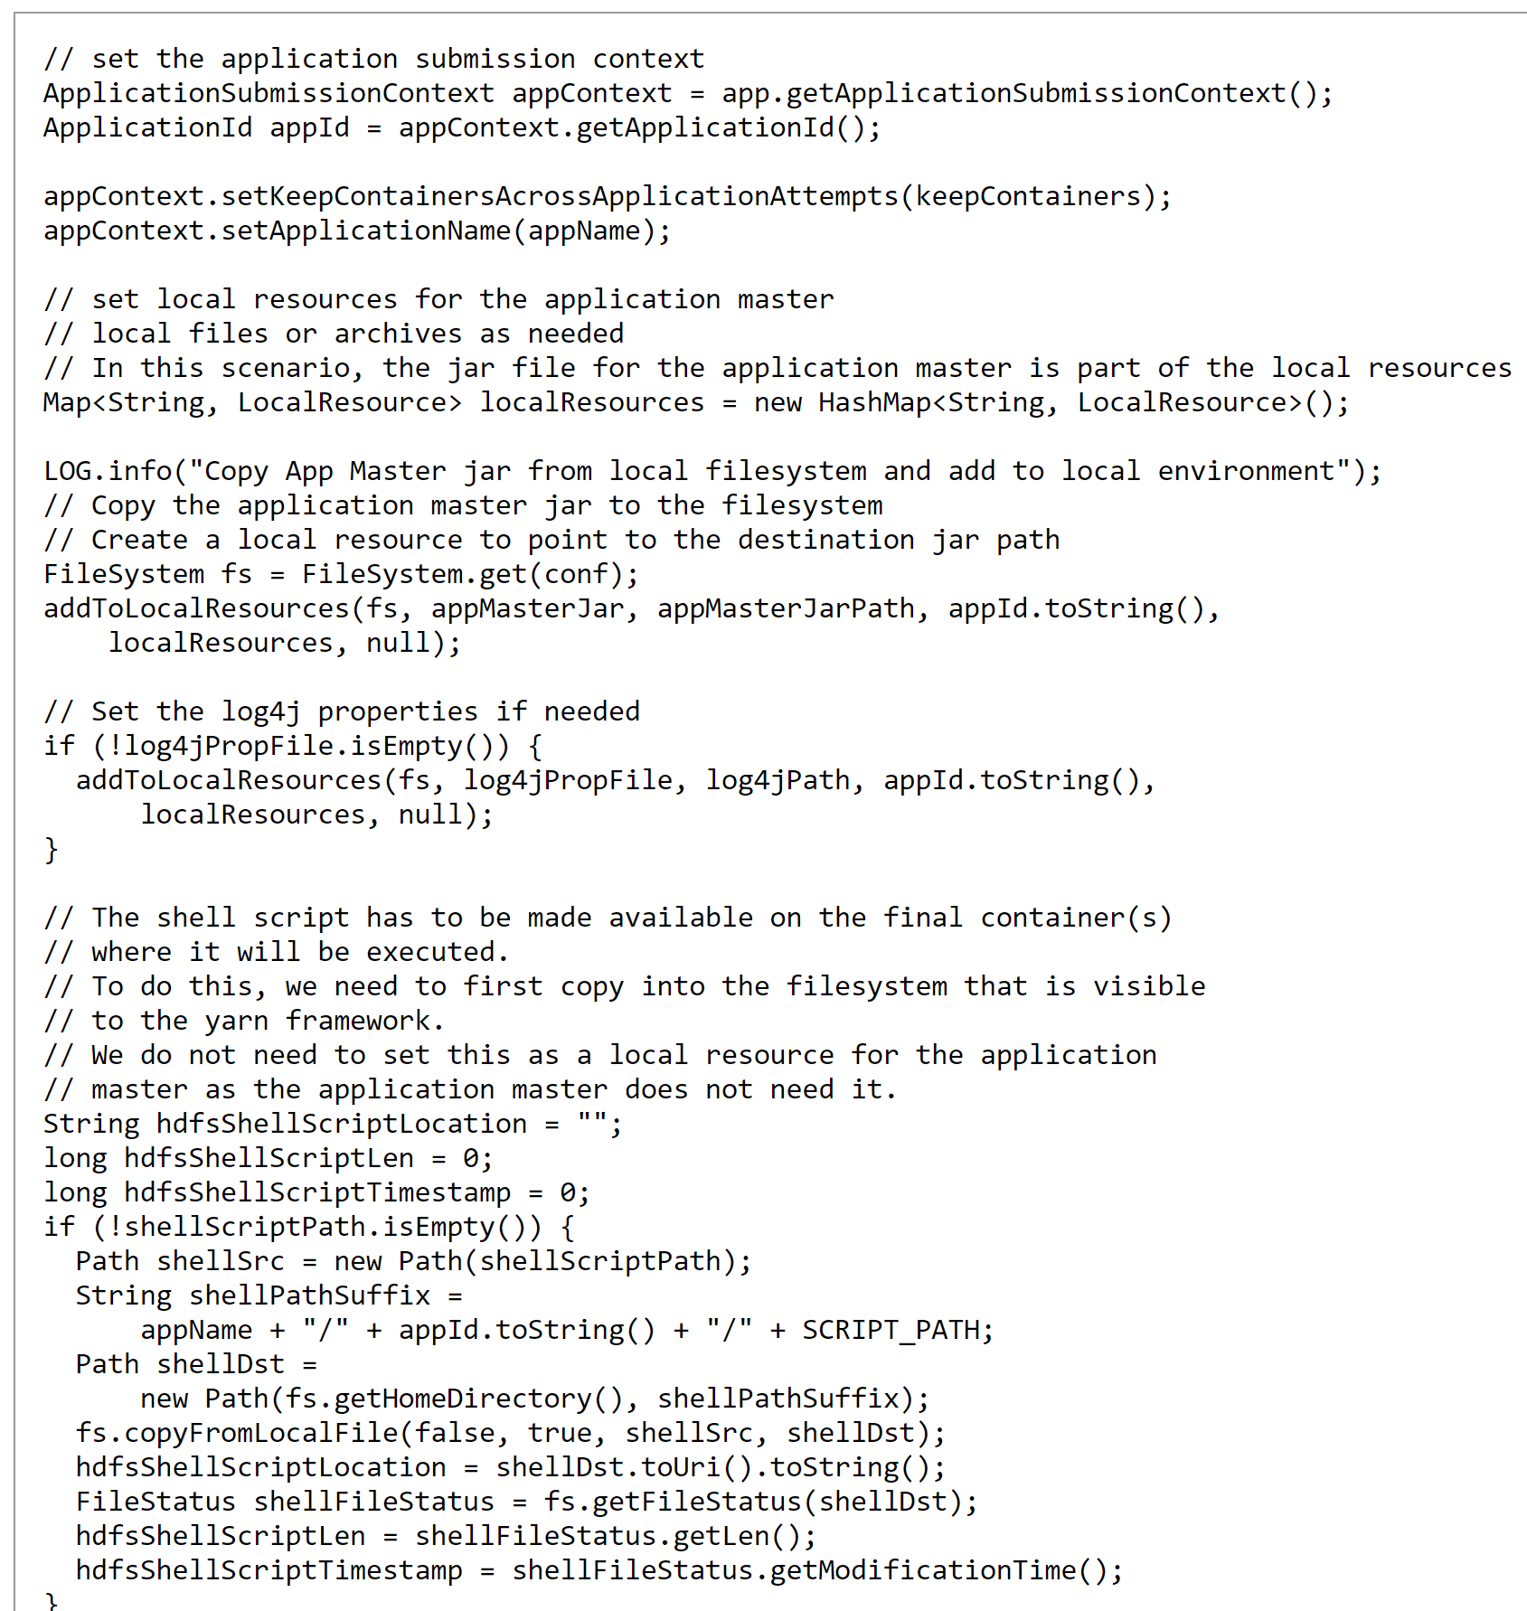
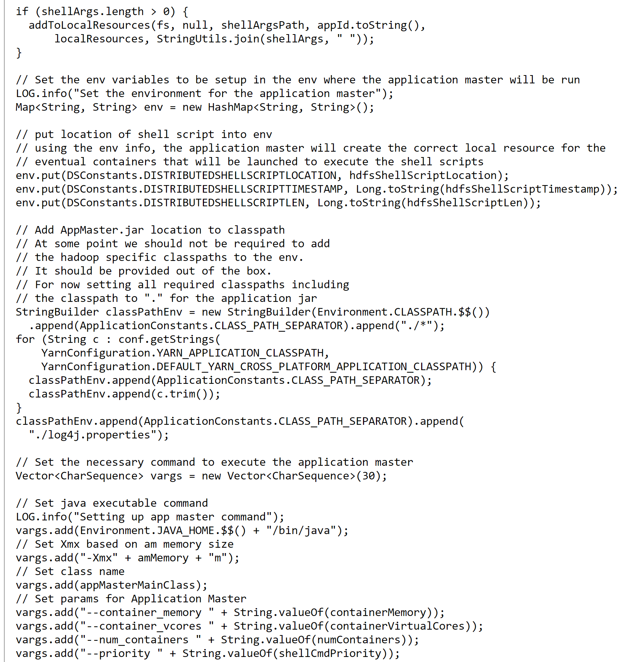
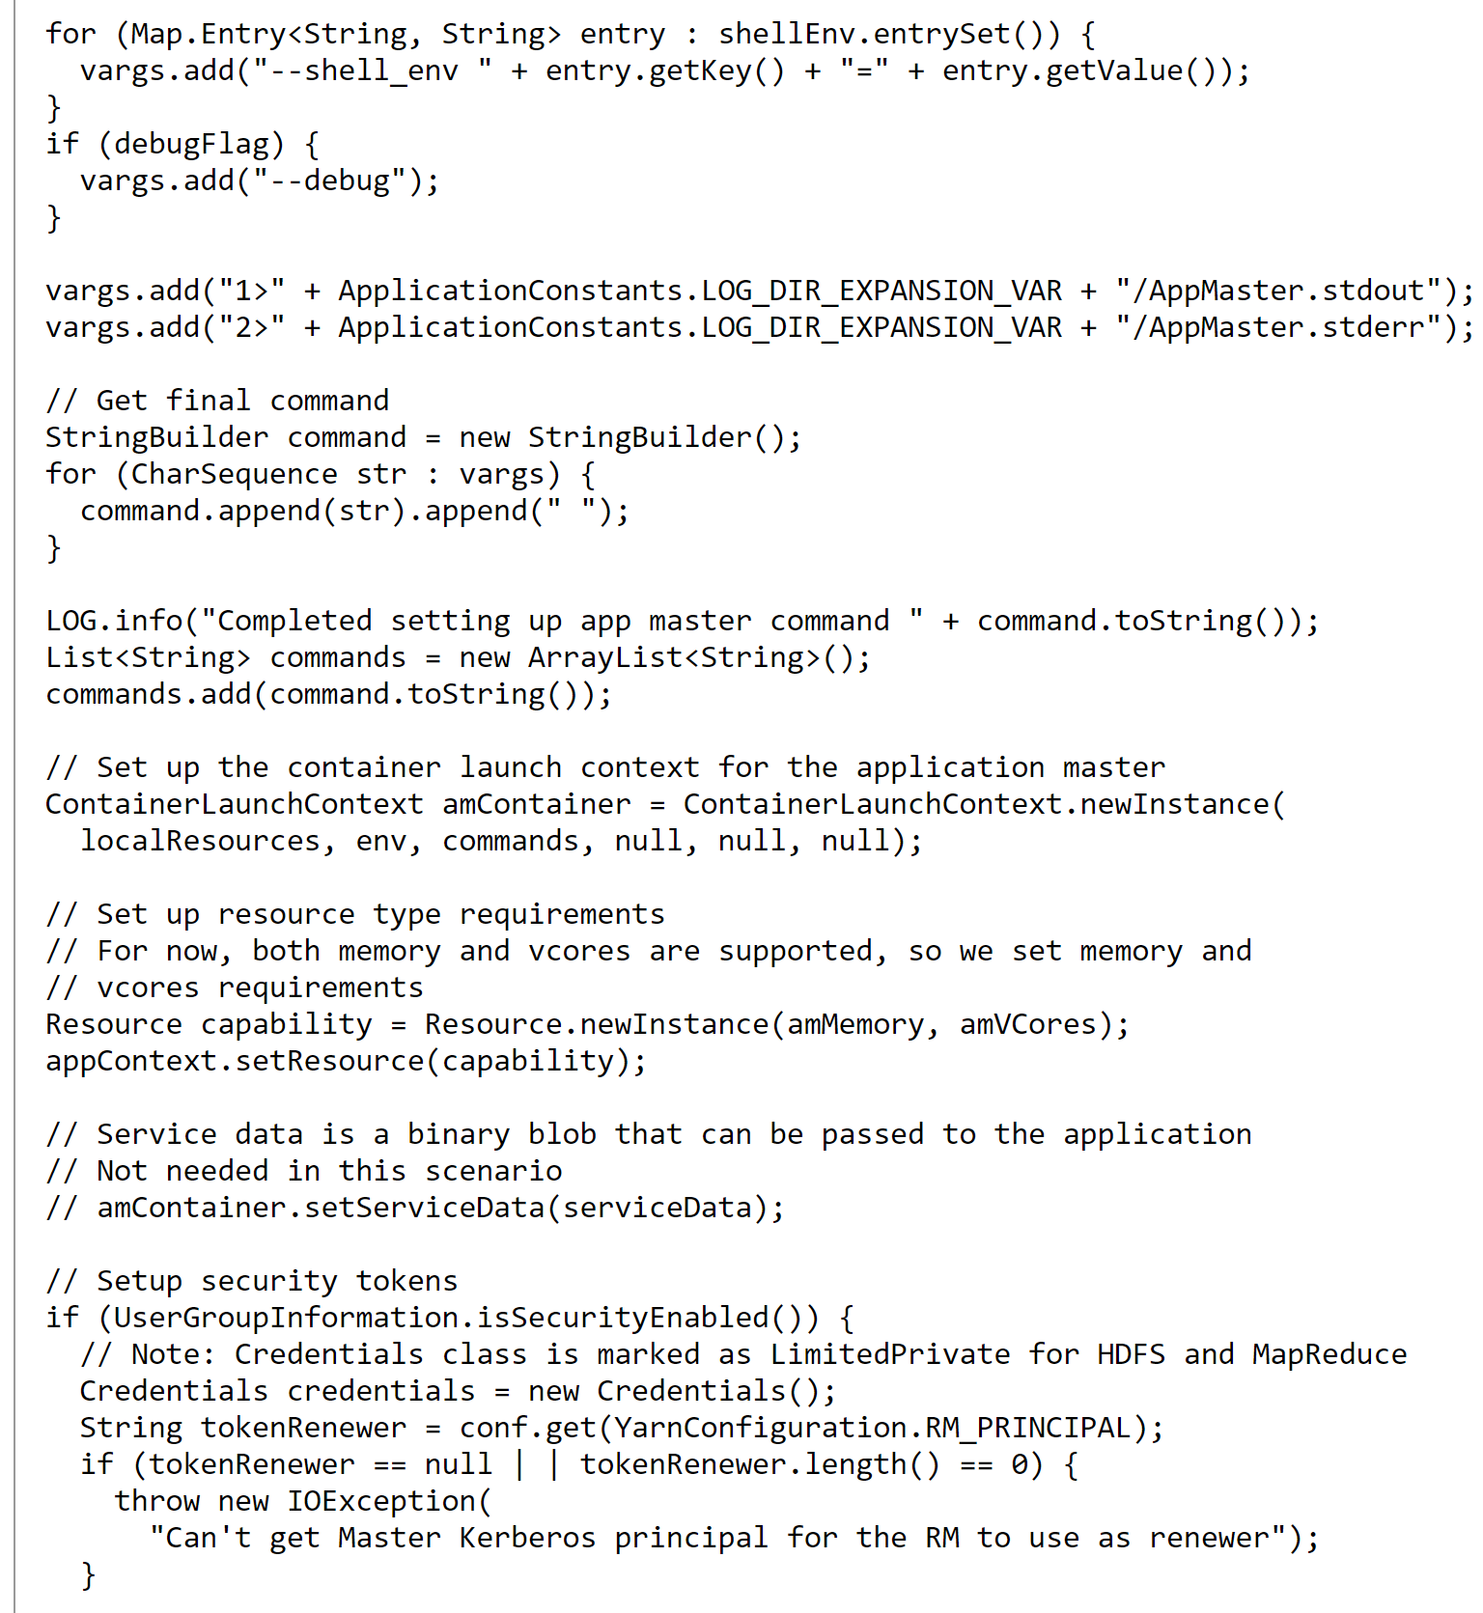
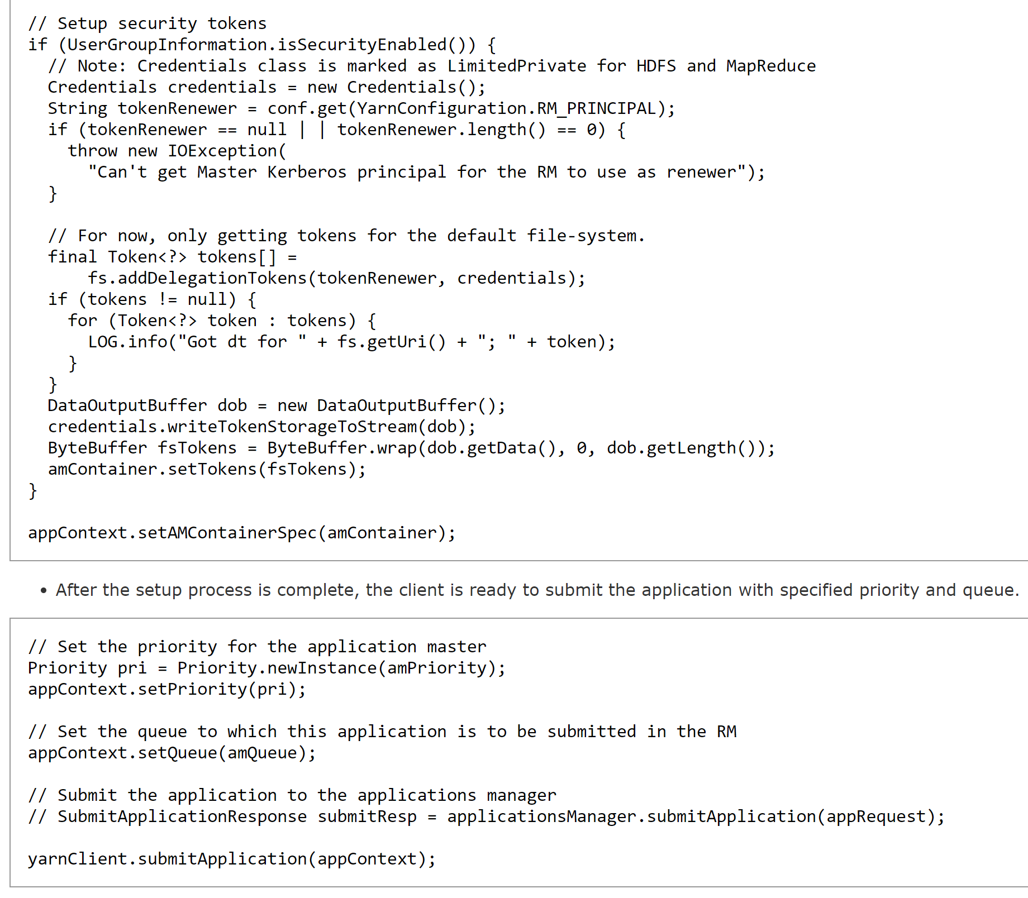
Launching App in Yarn … conf in java … >200 lines of code

Slide 51
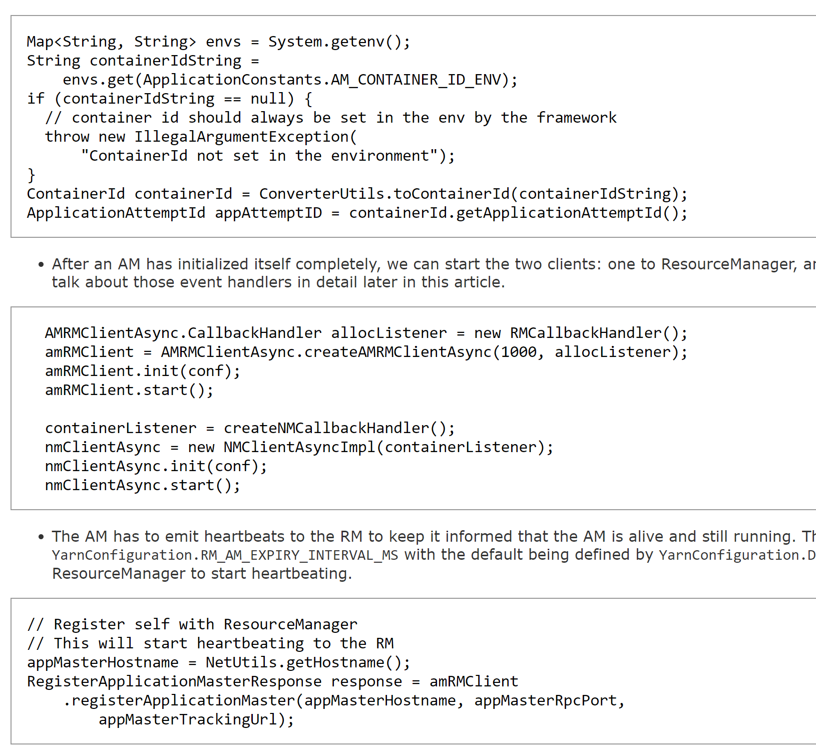
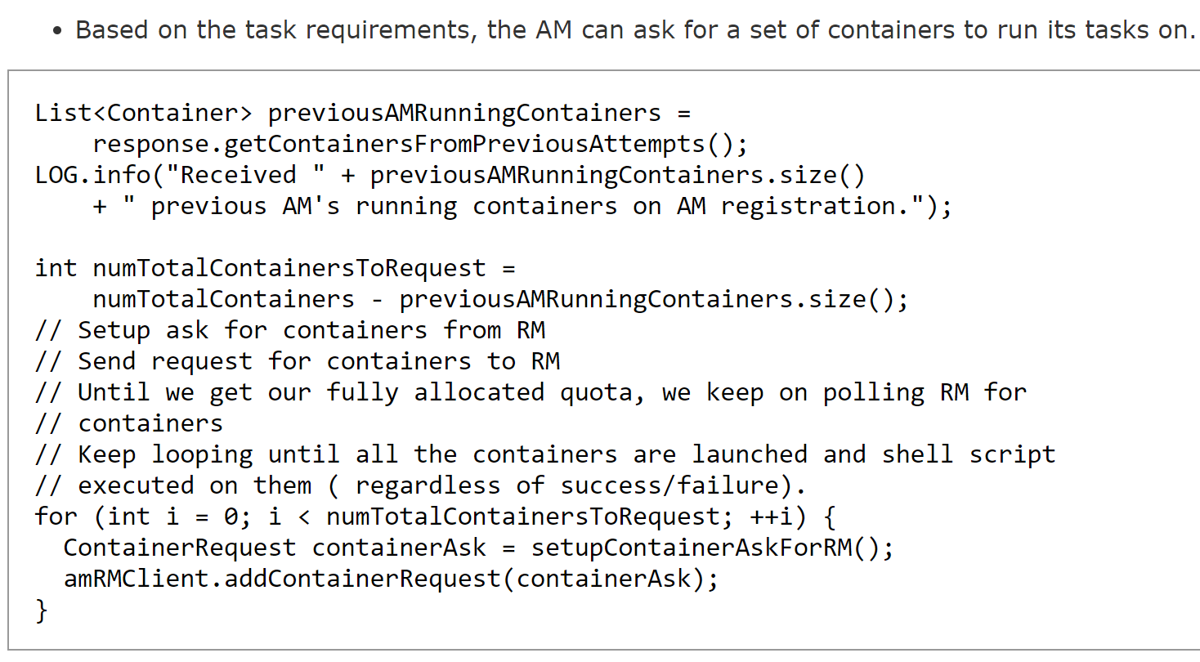
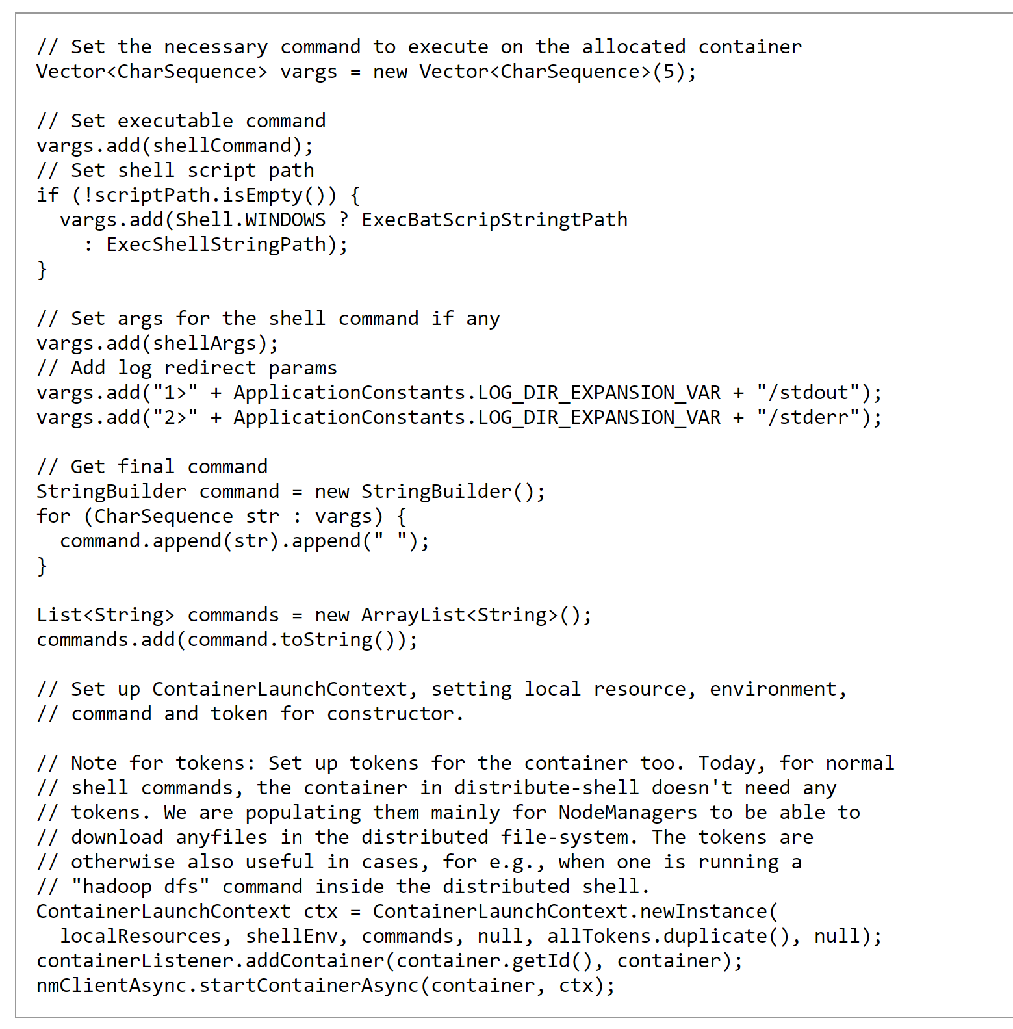
Just the beginning... Need also ApplicationMaster code!

Slide 52

Using Yarn api..

Slide 53


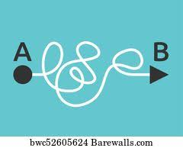

Launching app on Yarn ?
Builtin:
Spark-submit --master yarn
?
Simple App
(not distributed)
Declare in oozie workflow.xml
<action> <shell>...
Unpractical
Config + Web UI
Distributed
Hadoop App,
not spark
Reconsider !!
Maybe services
- Multiple oozie
- Kubernetes

Slide 54
Yarn Commands Line (not for launch)
$ yarn app -list
$ yarn app -status <applicationdId>
$ yarn app -kill <applicationId>
$ yarn logs -applicationId <applicationId>
$ yarn logs -containerId <containerId>

Slide 55
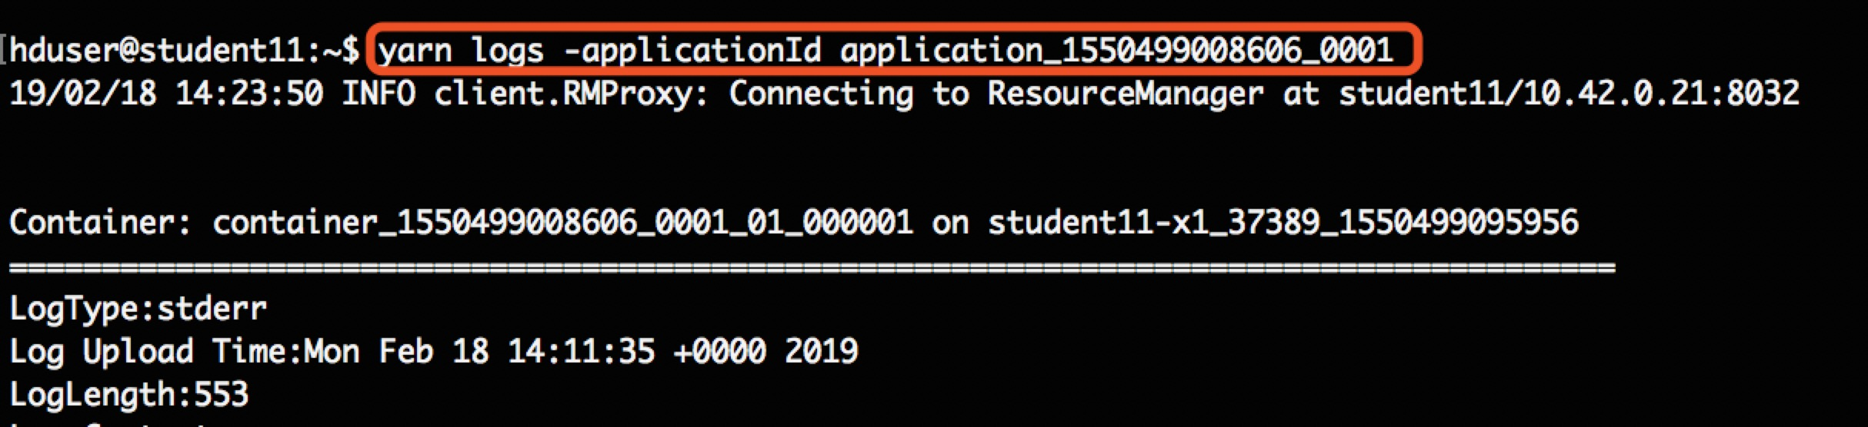


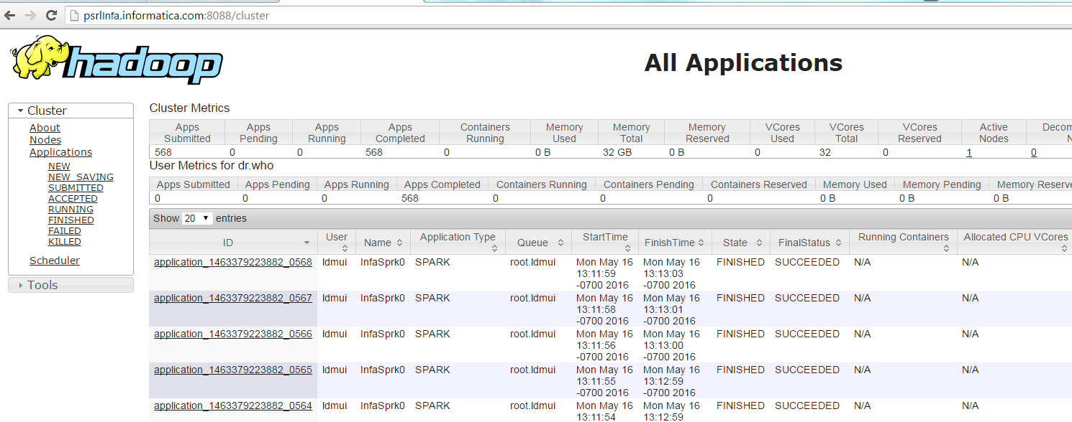
Yarn UI & Logs
As a developper, ops, admin, datascientist …
It is necessary to get logs to diagnose/launch/understand your job app
Web UI “not mandatory”, but (would have) help (if practical)

Slide 56
Yarn UI ...
No Filter
Slow
Click
Click
Click
Impossible to search
No Regexp
Paginated to 25 per page
No Criteria &&, ||, !
Yarn UI
No Scrolling Logs
Logs are un-structured (String lines)
No RestJson
No update
Only refresh page
no Real-Time
Full Log in page.. download XX Megas
Not a modern SPA
Truncate / timeout logs
No Ag-Grid
No Excel CSV export
No more evolution
No sorting
No GroupBy

Slide 57
Yarn Logs
Node
/proxy/container/port
NodeManager
When running Read from local disk
Http Rest
Web Yarnui
ResourceManager
when running
Container
stdout
Container
stderr
Container
Knox
is Container
Running?
Copy
“Log Aggregation”
when finished
Yarn Timeline (History) Server
When finished
Read from HDFS

Slide 58
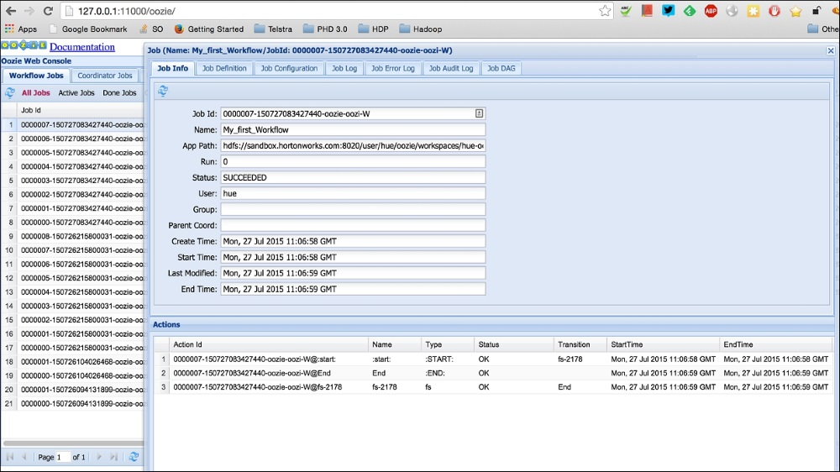
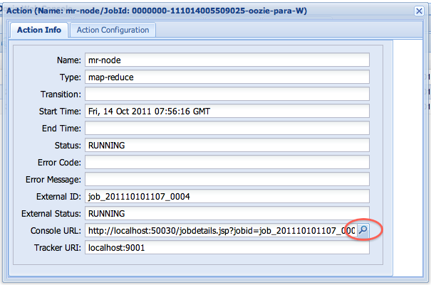
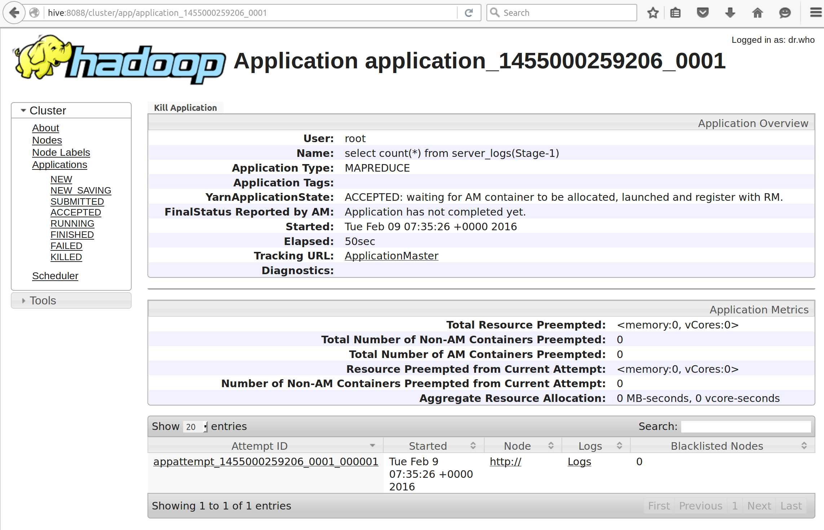
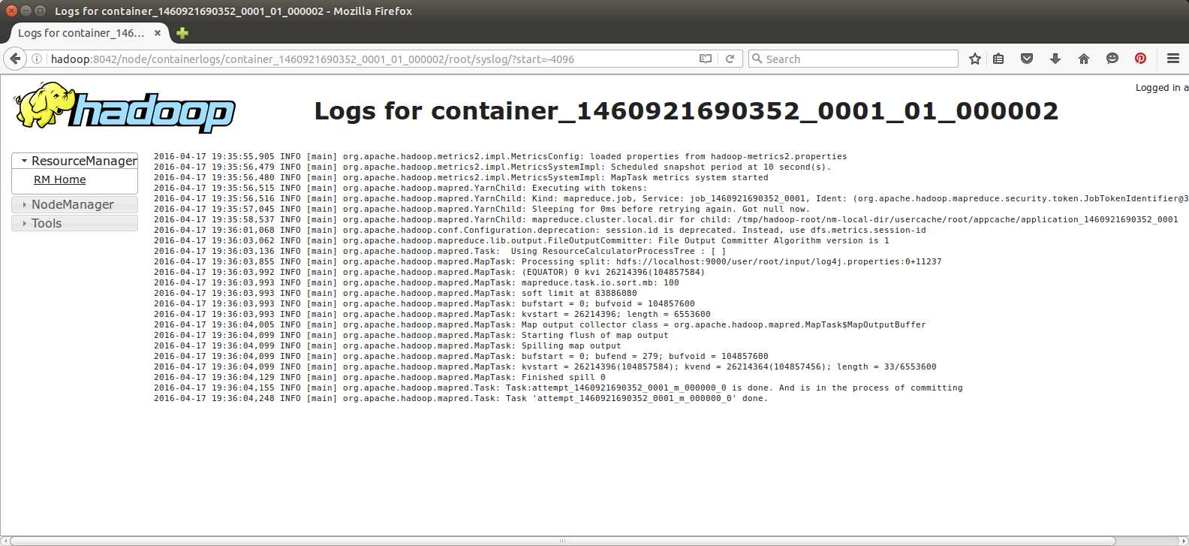
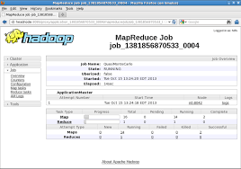
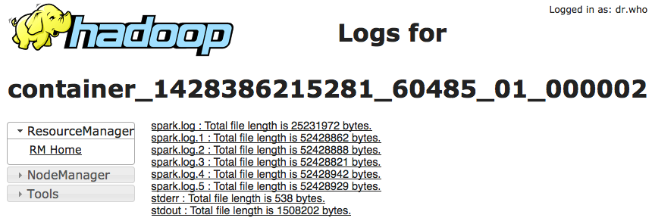
Ooozie → Yarn UI → Yarn Logs
1/ Find Oozie workflow Id
Example
Shell → spark-submit
7/ spark
6/ Yarn (spark-submit client)
5/ Mapreduce (SHELL) … call spark-submit --mode cluster
3/ Oozie shell action = “Mapper” of Map-Reduce in Yarn
2/ oozie-action
4/ Console URL = url in Yarn (Proxy or History)
11/ stdout !!
8/ appmaster application attempt 1
10/ log files page
9/ application (example: Reduce for shell)

Slide 59
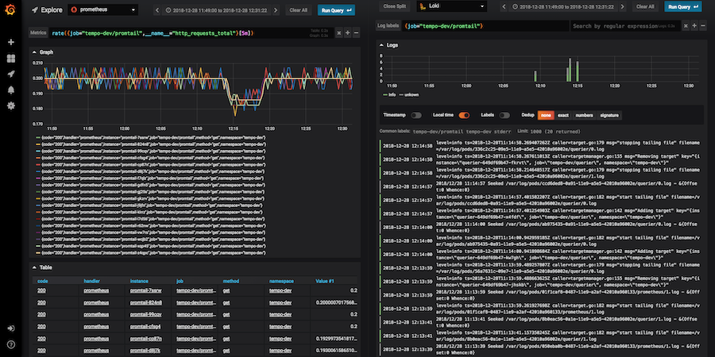

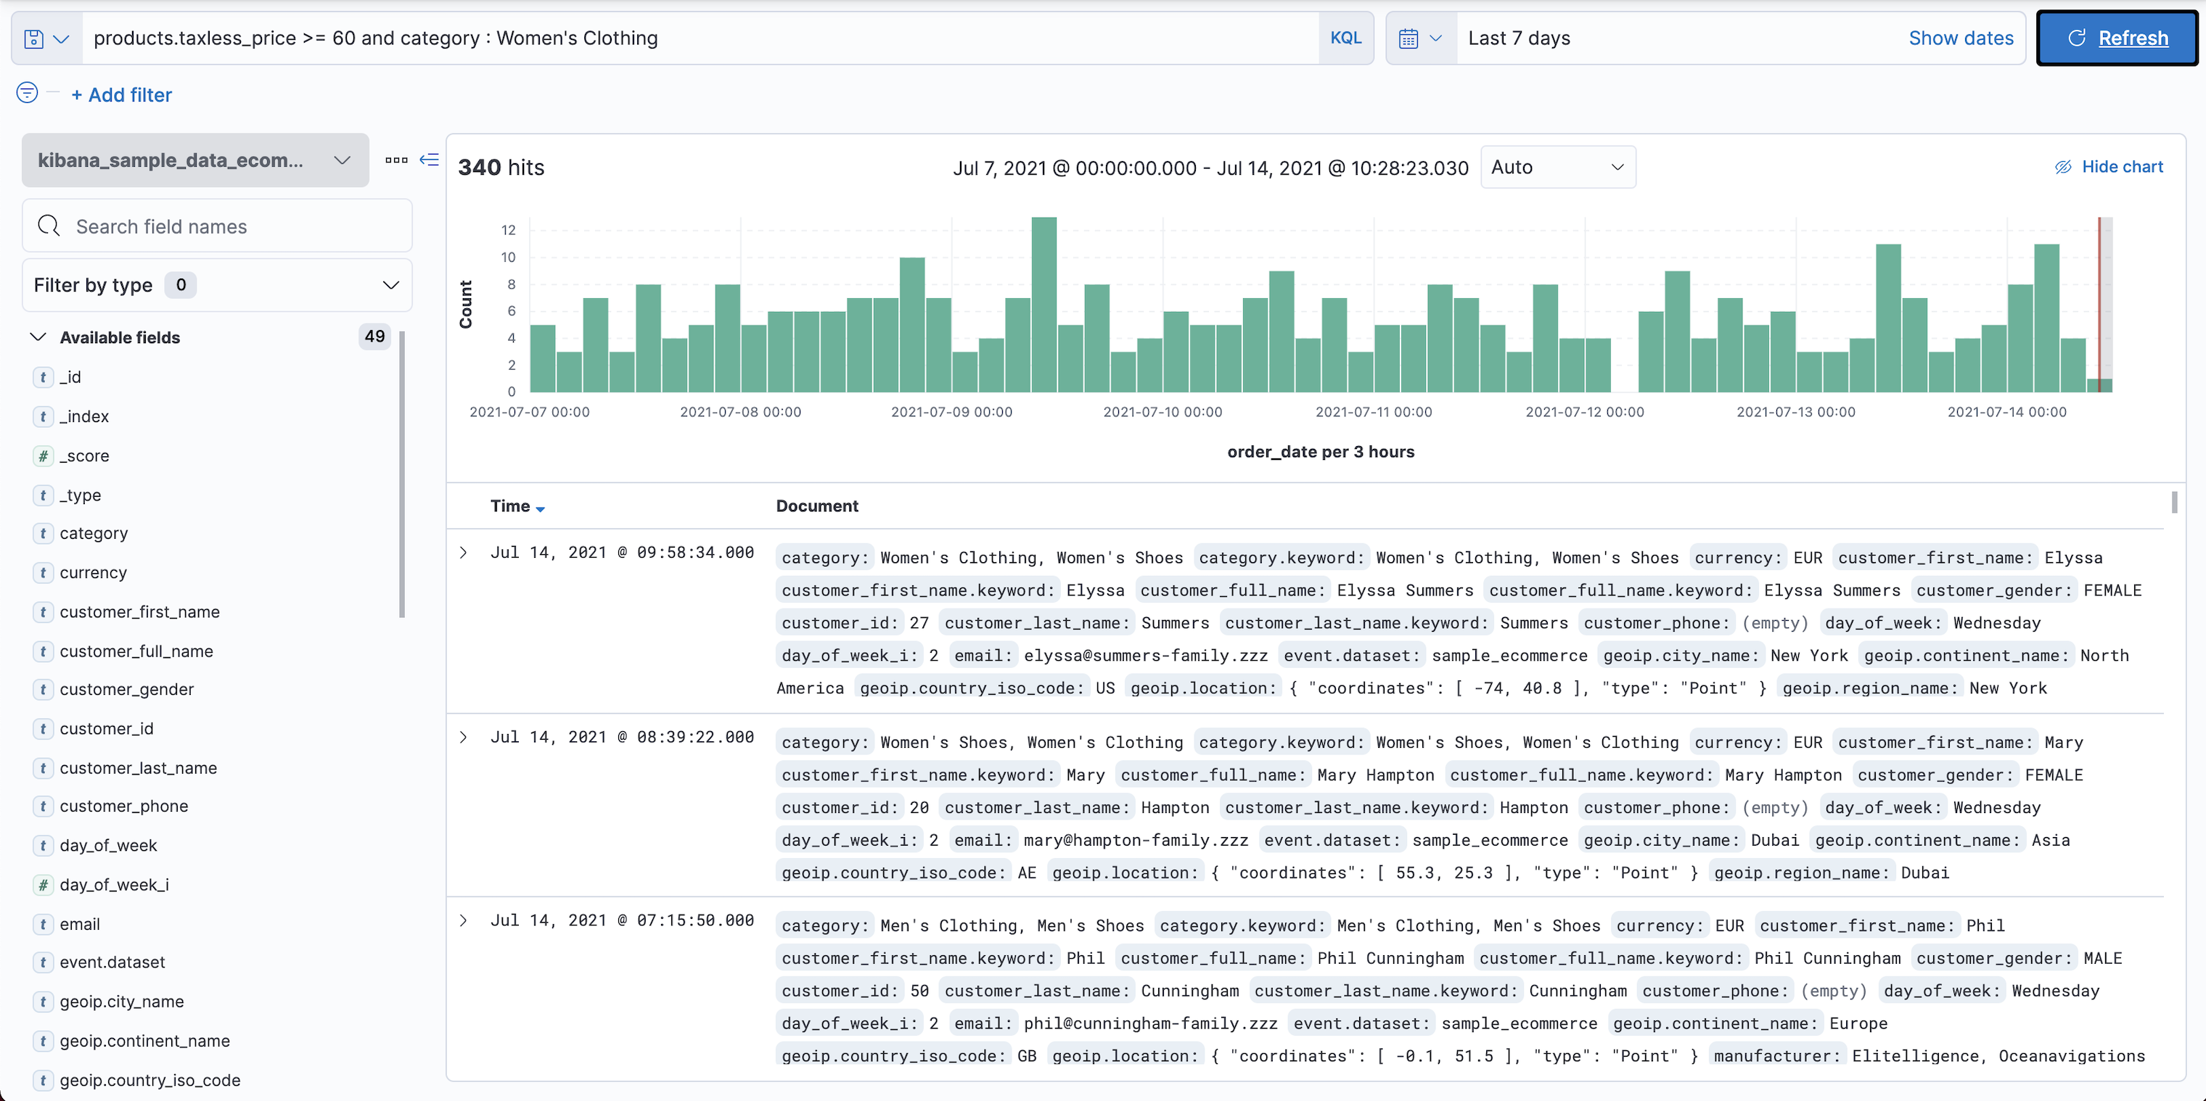

Yarn Log Alternatives...

Slide 60
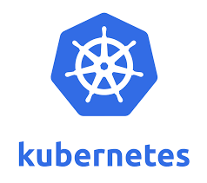
Yarn Summary / Alternative(s)
Mesos was deprecated … Yarn is also (complex / inneficient)
Queues
Logs
Operators
or
or

Slide 61
Yarn Missing Features… Orchestrator + DataLineage
No “CRON” (periodic scheduling, like 2 */5 MON-FRI * * * )
No simple packaging to launch
No trigger after data change
No workflow between data / job

Slide 62
Apache Oozie

Slide 63
Oozie Features simpler than / missing in Yarn
Orchestrator: “CRON” (periodic scheduling, like 2 */5 MON-FRI * * * )
Workflow.xml <action><shell> <command><arg><env>.. <file>
simple packaging to launch
workflow between action

Slide 64
Oozie Model
1 start
1 end
1 kill
*
Workflow
*
1 ok
1 error
workflow.xml + config.xml
Action Node
*
Action
1
*
Orchestrator
orchestrator.xml + config.xml
Shell
Spark
Hdfs
Bundle
..

Slide 65
workflow.xml
<workflow-app name="[WF-DEF-NAME]" xmlns="uri:oozie:workflow:0.3"> <start to="[NODE-NAME]"/>
<end name="end"/>
<action name="[NODE-NAME]">
<shell xmlns="uri:oozie:shell-action:0.1">
<job-tracker>[JOB-TRACKER]</job-tracker>
<name-node>[NAME-NODE]</name-node>
<prepare>
<delete path="[PATH]"/><mkdir path="[PATH]"/>
</prepare>
<job-xml>[SHELL SETTINGS FILE]</job-xml>
<configuration>
<property>
<name>[PROPERTY-NAME]</name><value>[PROPERTY-VALUE]</value>
</property>
</configuration>
<exec>[SHELL-COMMAND]</exec>
<argument>[ARG-VALUE]</argument>
...
<env-var>[VAR1=VALUE1]</env-var>
...
<file>[FILE-PATH]</file>
...
</shell>
<ok to="[NODE-NAME]"/>
<error to="[NODE-NAME]"/>
</action>

Slide 66
Config .xml / .properties
All ${variable} in coordinator.xml / workflow.xml are replaced
When launching
$ oozie job -config config.properties -start
or
$ curl -X POST http://oozie/job?action=start -d @config.properties
oozie.wf.application.path= hdfs://a/b/workflow.xml
user.name=john.smith
variable=xx
otherVariable=yy

Slide 67
Oozie Architecture
HDFS
Http Rest
Web UI
Oozie
Yarn RM
Knox
Http Gateway
Oozie
Yarn RM
Relational DB
Ex: postgresql

Slide 68
Oozie Command Line
$ oozie job -start -config <config.properties>
$ oozie job -status <jobId>
$ oozie job -kill <jobId>
$ oozie jobs -filter user=<U>\;name=<N>\;group=<G>\;status=<S>\; frequency=<F >\;startcreatedtime=<SC>\;endcreatedtime=<EC>
\;sortBy=<SB> ...
$ oozie coordinator -start -config <config.properties>
$ oozie coordinator -suspend <coordId>
$ oozie coordinator -resume <coordId>
$ oozie coordinator -kill <coordId>
$ oozie coordinator -change <coordId> -value key=value

Slide 69
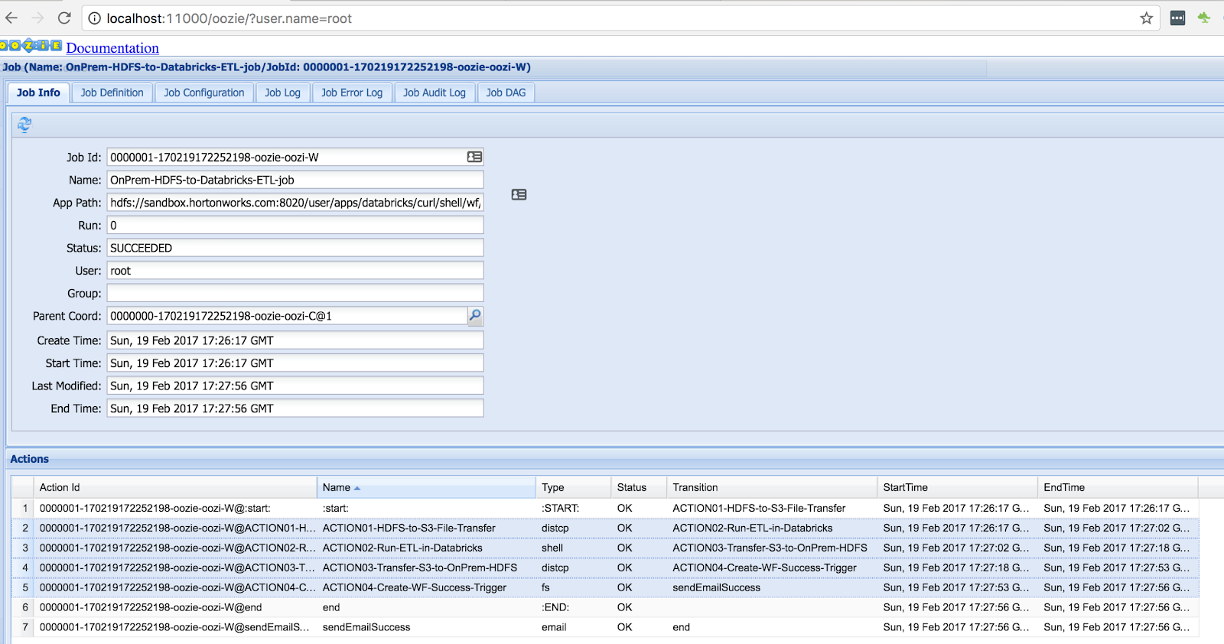
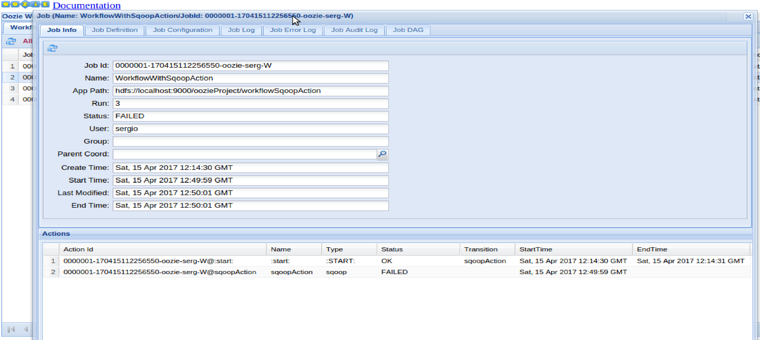
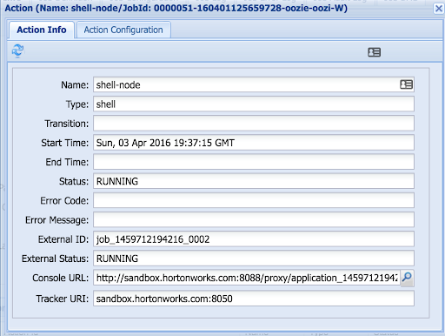
Oozie Web UI
Coordinator
Workflow
Action = yarn job
Coord executions
= launched workflows
Workflow actions

Slide 70
Oozie Web UI ...
Can not search
(not easily)
No criteria composition
Unpractical
Page of 20..
Not well integrated with Yarn
Still need Yarn UI
No refresh / realtime
Similar problems as Yarn UI …
Oozie Web UI
Strange selection/ modal / focus
behaviors
Not evolving
Bugs
No selection by url

Slide 71
Oozie Summary
OK to fill missing Yarn
to simplify launching Yarn containers
Simple http Rest / Command line tool
Verbose yet simple xml + properties
Unpractical Web UI
Still
No Datalineage between data / job
No trigger on data change

Slide 72


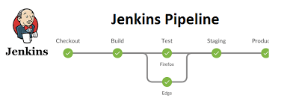

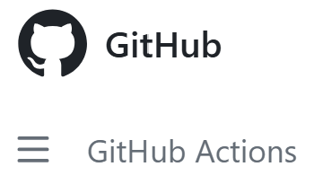


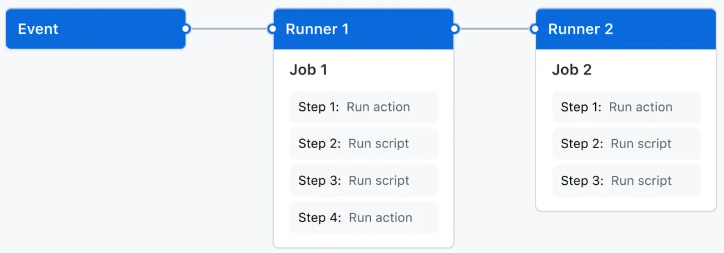
Oozie Alternatives
Livy …. to start simple Spark actions
Any Orchestrator …. with plugin extension for Yarn support
Etc..
Etc..
Etc..

Slide 73
Apache Livy

Slide 74
Livy Architecture + Features
Spark (Batch)
Livy
Yarn RM
Spark (Interactive Session)
Relational DB
Ex: postgresql

Slide 75
Livy sample
file: app.json
{
"file": "hdfs:///myapps/hello-spark.jar",
"className": "myapp.HelloSpark",
"args": ["hdfs:///inputs"],
"jars": [
"hdfs:///myapps/mylib.jar"
],
"driverMemory": "1g",
"executorMemory": "5g",
"executorCores": 8,
"numExecutors": 2
}
$ curl -X POST -H 'Content-Type: application/json' \
http://livy:8998/batches -d @app.json \
$ curl http://livy:8998/batches | jq '.'
$ curl http://livy:8998/batches/${batchId}/log

Slide 76
Yarn+Oozie+Livy… Missing Feature: DataLineage, Data Trigger Orchestration
hdfs:///data/dir1
hdfs:///data/dir2
Job1 to compute data: dir3 = func1(dir1, dir2)
hdfs:///data/dir3
hdfs:///data/dir4
Job2 to compute data: dir5 = func2(dir3, dir4)
hdfs:///data/dir5

Slide 77
Job (Input, Output) re-eval on input change
*
JobInput
1
Job
DataSet
JobOutput
1
*
When detecting external change to DataSet => search for JobInputs => launch Jobs
When Job finish => JobOutput changed => launch successor Jobs for inputs

Slide 78
DataLineage DataSet+Job
ds1
ds
Job1
ds3
ds2
Job2
ds5
ds4
Sub graph : Data dependency
Sub graph : Job orchestration
Job1
Job2
ds1
ds
ds3
ds2
Gant Diagram (cron + duration)
ds5
Job1
ds4
start
?
delay
Job2

Slide 79
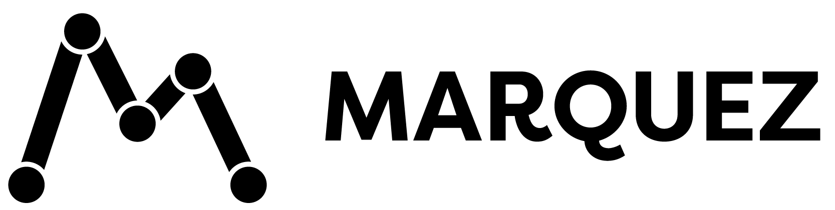

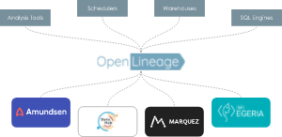
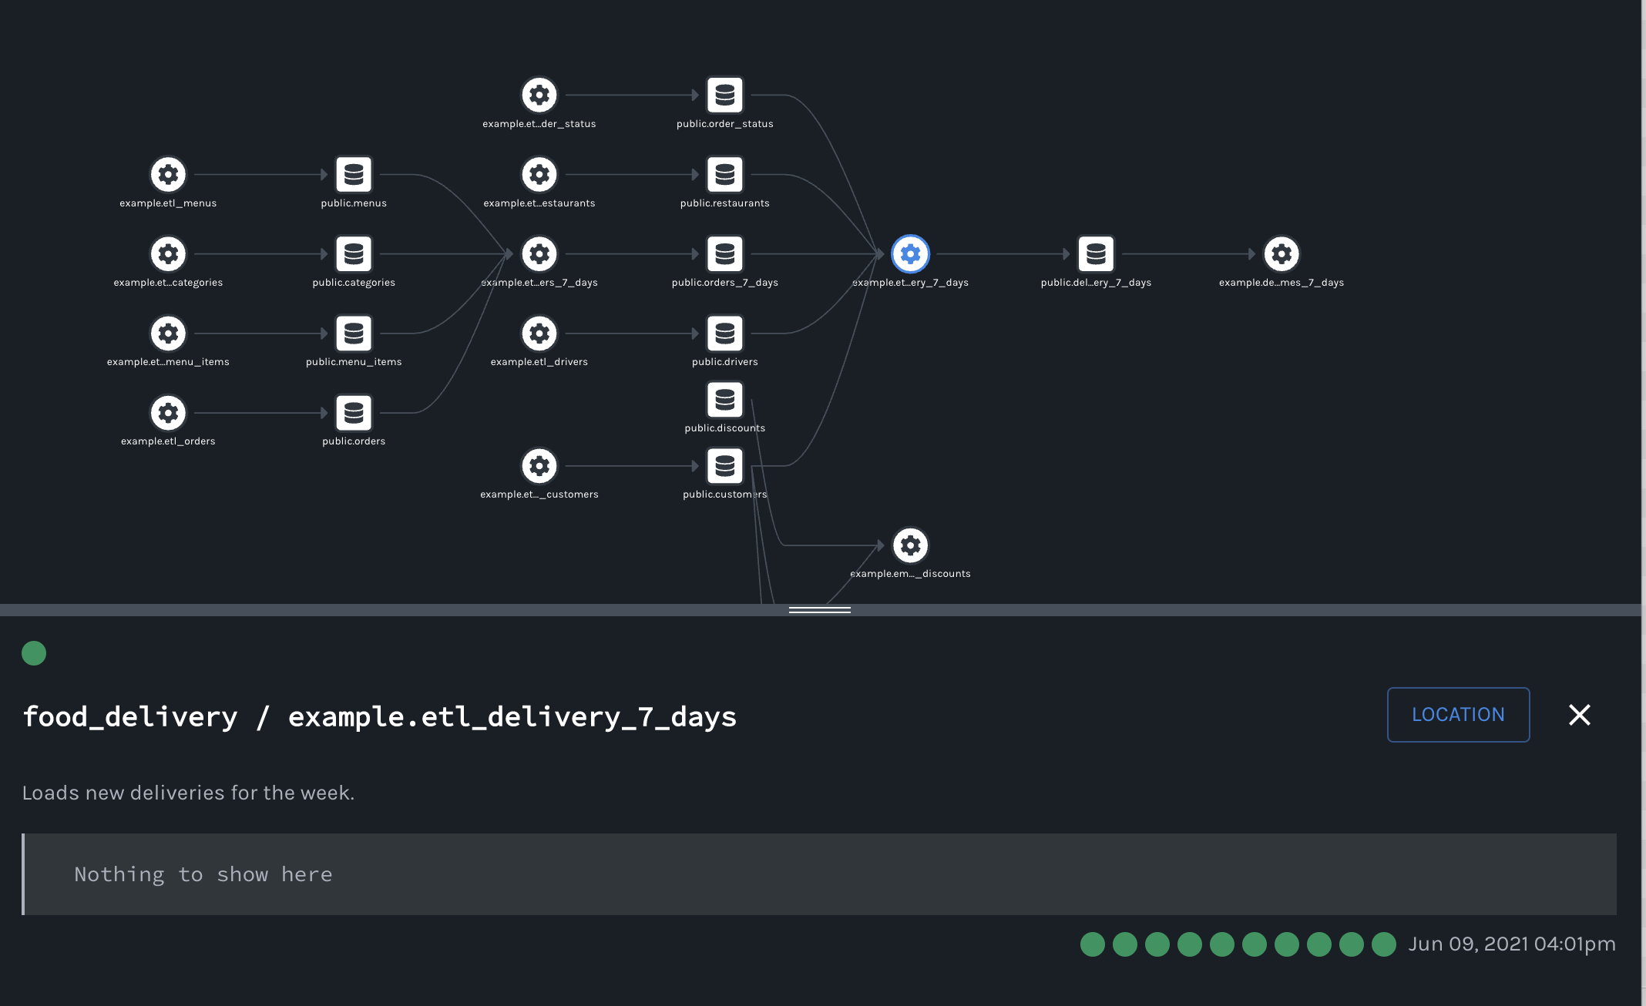
Example DataLineage Spec / Implem OpenLineage / Marquez
https://openlineage.io/
https://marquezproject.github.io/
$ curl -X POST http://openlineage/api/v1/lineage \
-H 'Content-Type: application/json' \
-d '{
"eventType": "START",
"eventTime": "2020-12-28T19:52:00.001+10:00",
"run": { "runId": "d46e465b-d358-4d32-83d4-df660ff614dd" },
"job": { "namespace": "my-namespace", "name": "my-job" },
"inputs": [{ "namespace": "my-namespace", "name": "my-input" }]
}'

Slide 80
to be continued … Part5: High-Level focus HiveMetaStore, Parquet, Spark

